Slide 1
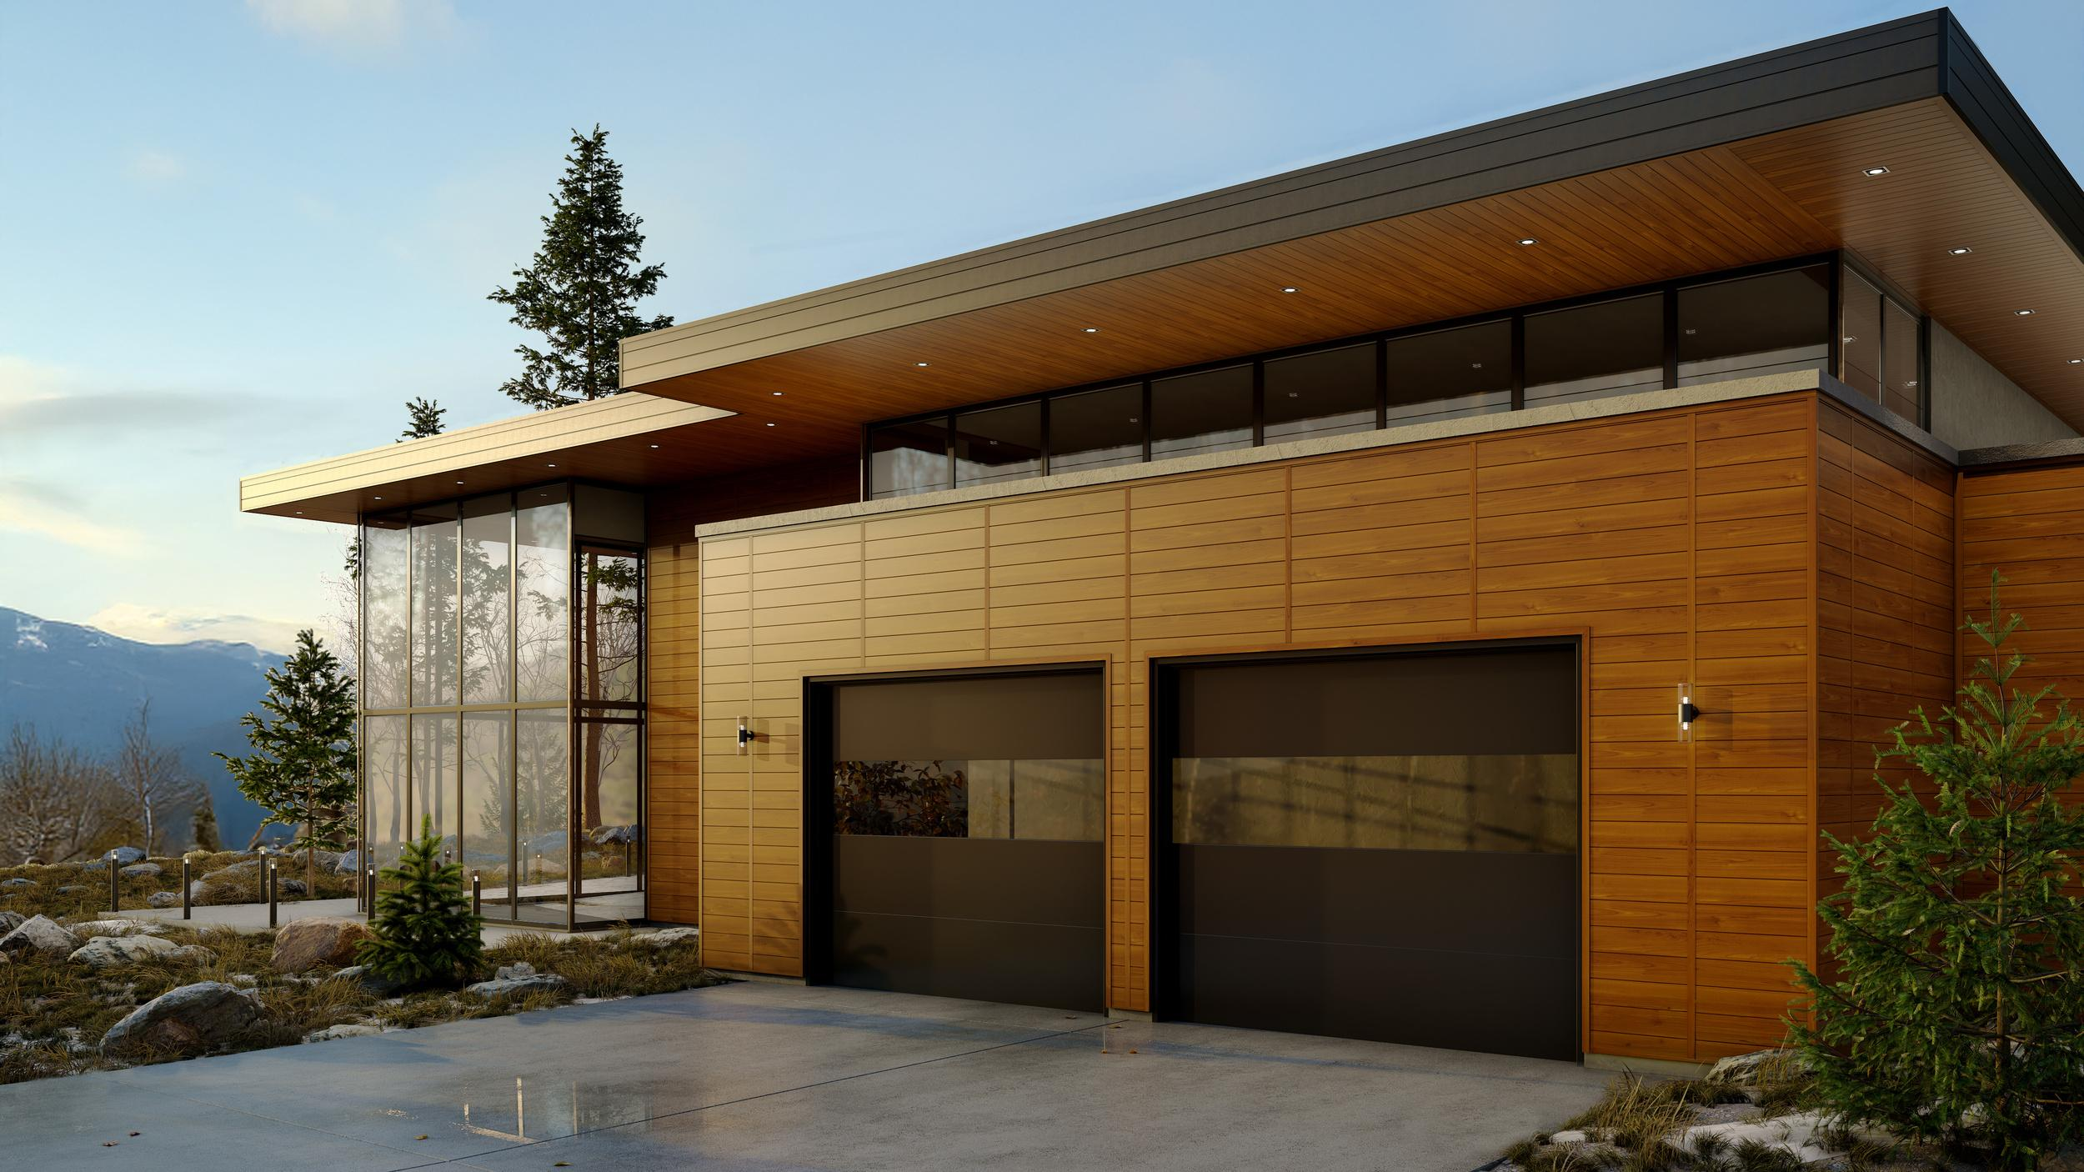


A NEW ARCHITECTURAL ERA
Notes:
Slide 1:
For what feels like forever, architects have had to make this really tough choice when it comes to the outside of our buildings.
But what if that choice just disappeared?
Today we’re diving into what could be a whole new era in architecture – one that’s designed to end that old compromise for good.

Slide 2
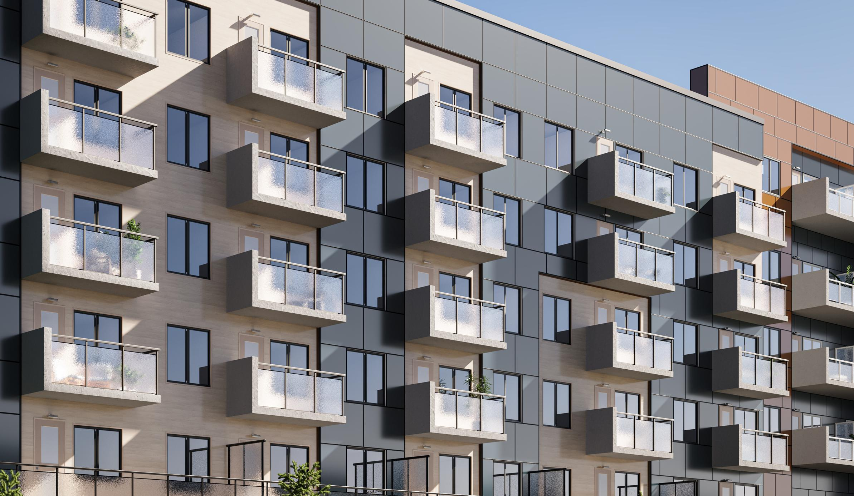

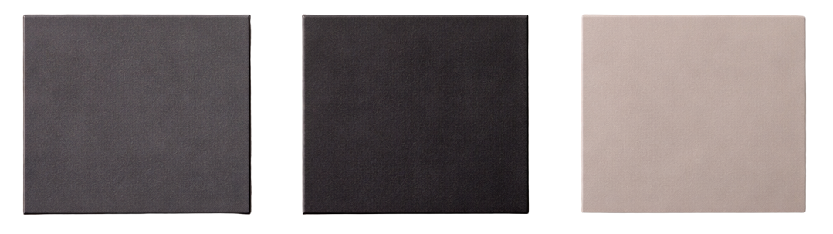
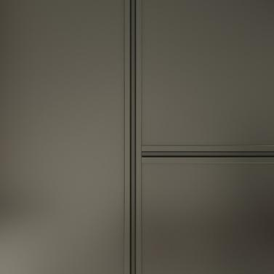
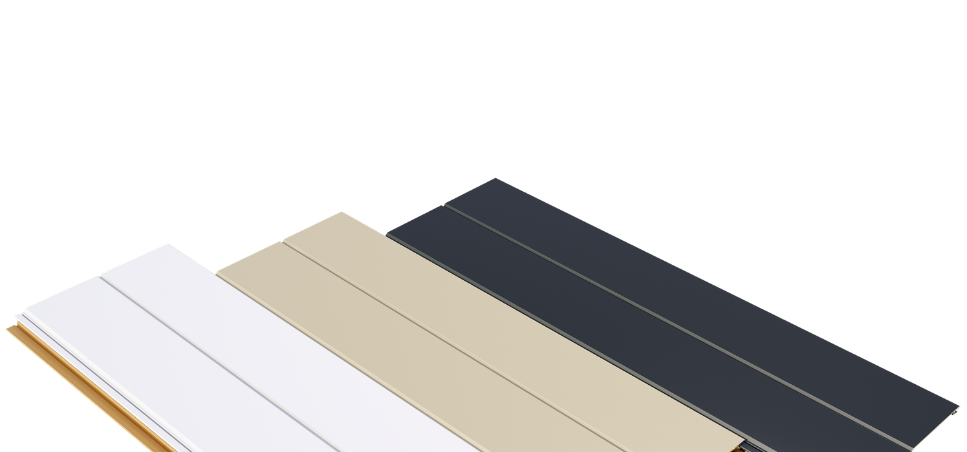
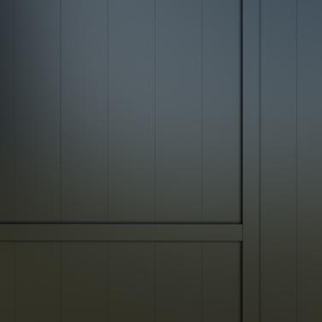
For centuries, architects have faced a fundamental compromise...
Notes:
Slide 2:
Think about it – every single building you see is the result of a thousand different decisions. And for generations, one of the biggest headaches has been this constant battle between the architect’s pure, beautiful vision, and the harsh realities of weather, time, and wear and tear.

Slide 3
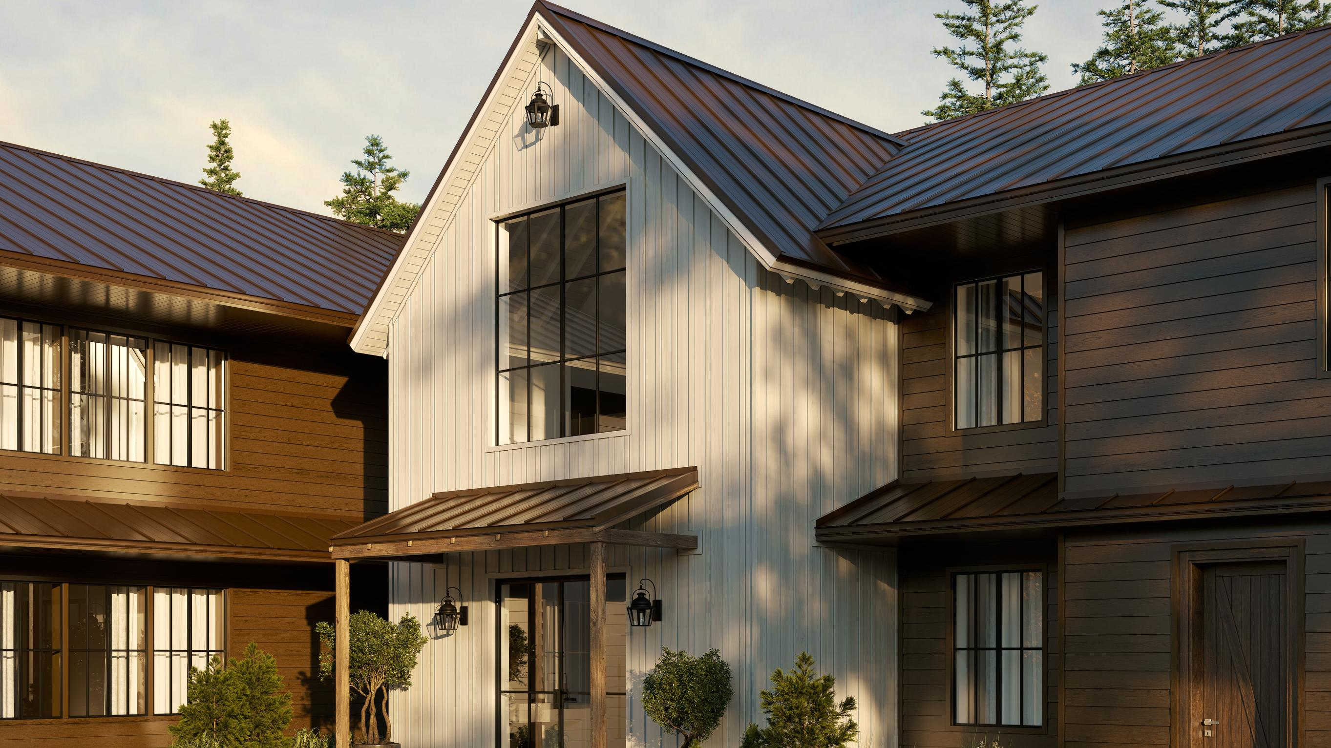
Must we choose between beauty that inspires and performance that endures?
Notes:
Slide 3:
So that really brings us to the big question: do we have to pick one?
Inspiring beauty OR lasting performance.
Or can we actually, finally, have both?
Let’s take a look at the innovation that says “yeah, you can.”

Slide 4
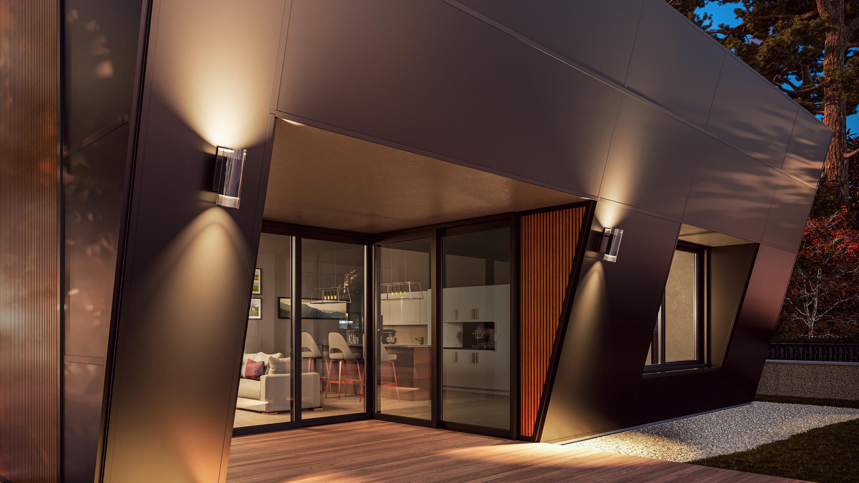
1) THE FACADE COMPROMISE
Notes:
Slide 4:
Okay, so to really wrap our heads around why this is such a big deal we’ve got to look at the problem it’s trying to solve. Let’s call it “The Façade Compromise”.
This is all about the stuff we’ve always used. You know, wood, fiber cement, or even just a simple coat of paint.

Slide 5
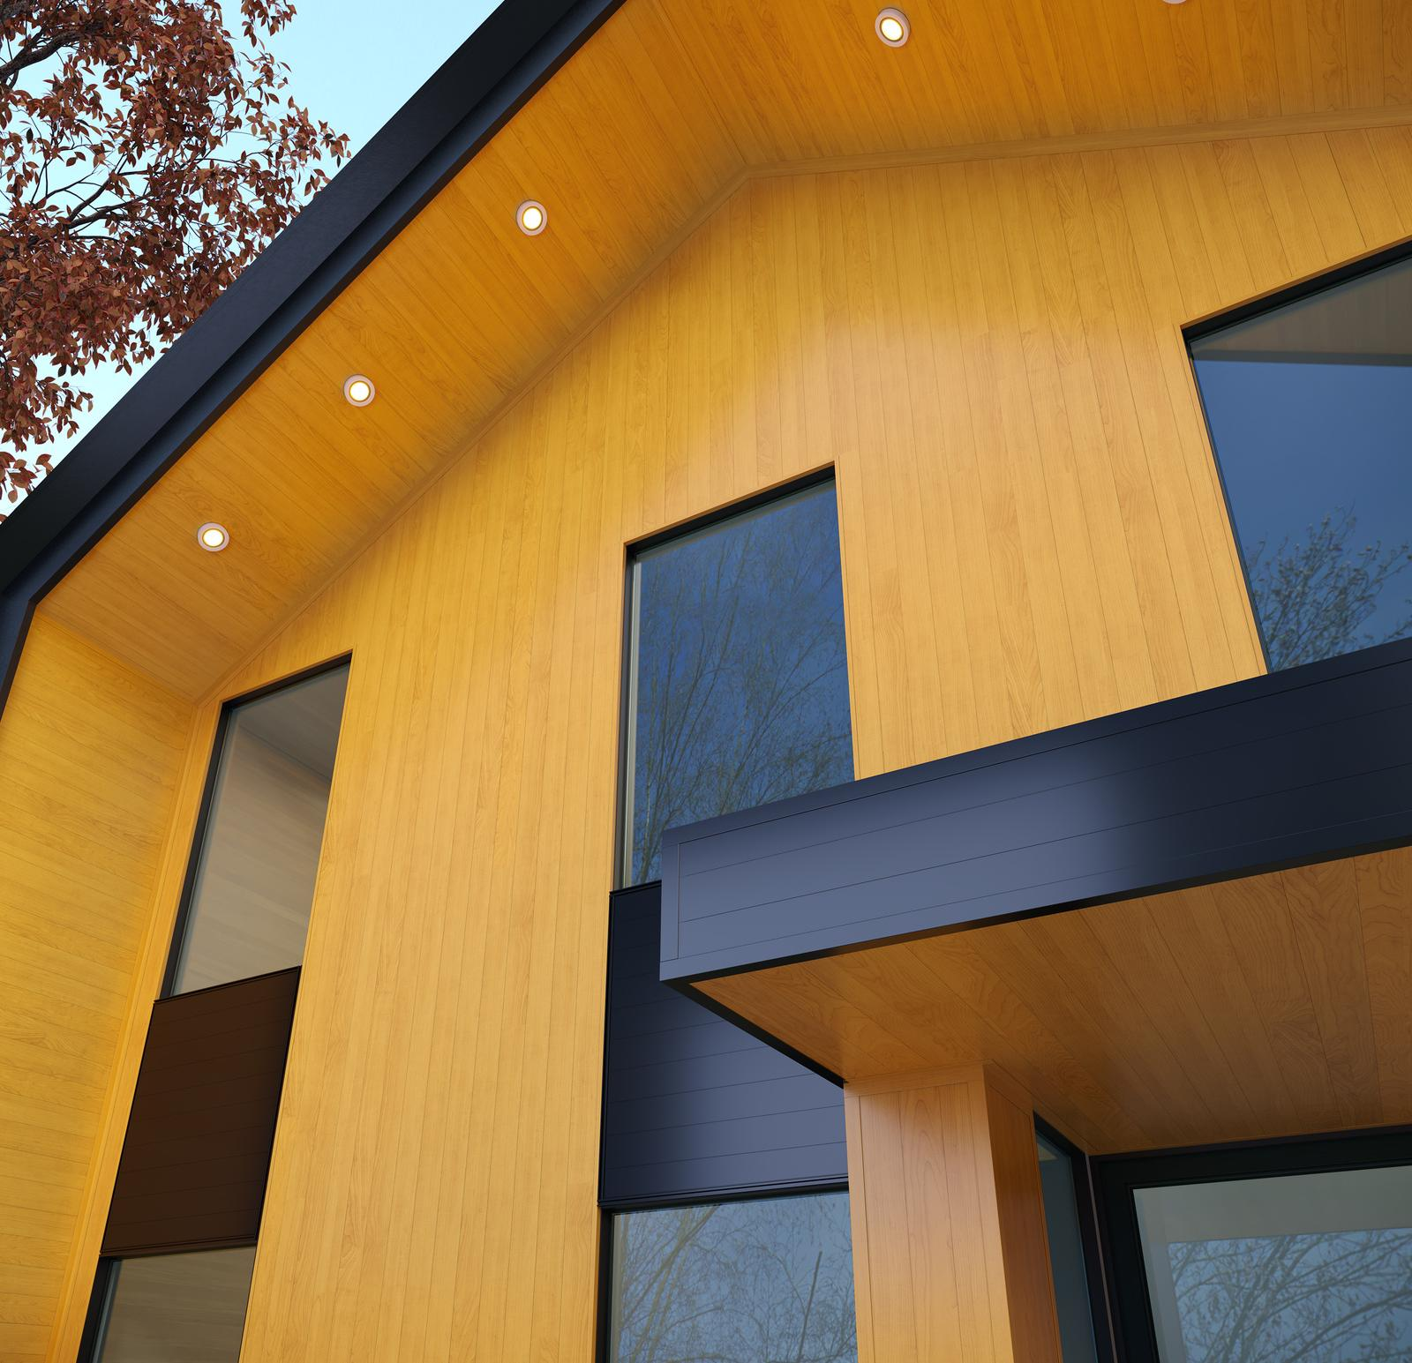
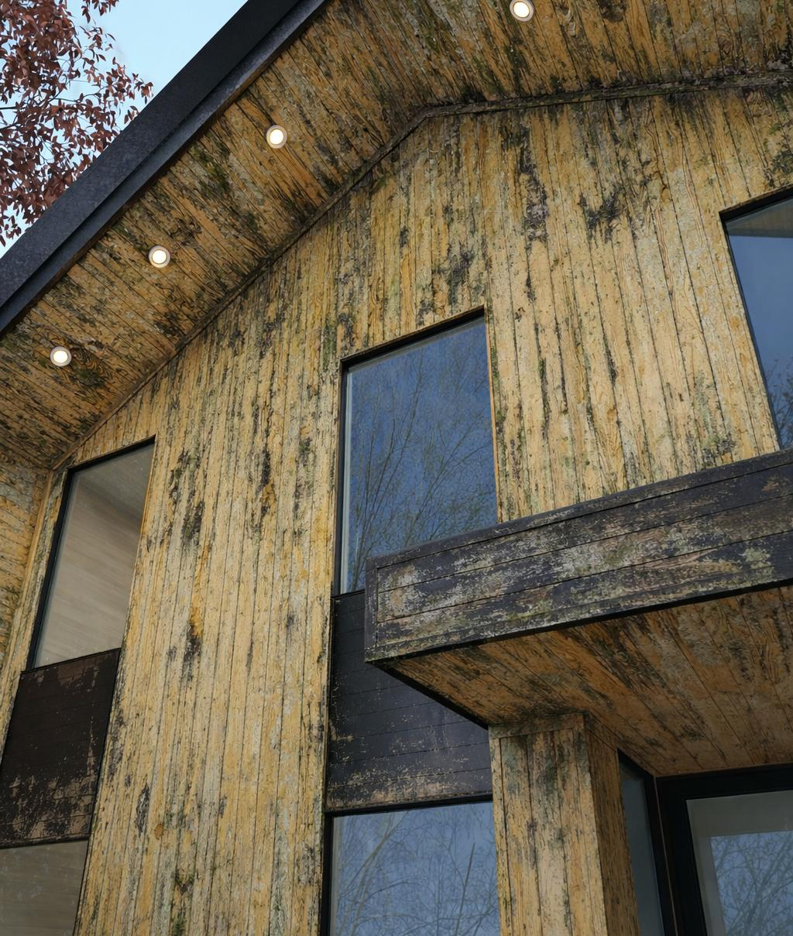
Aesthetic Vision vs. Harsh Reality
Notes:
Slide 5:
So, picture this – on one hand, you’ve got the architect’s dream. Right? Gorgeous clean lines, rich textures, amazing colours. But then, reality kicks in. Wood warps, it rots. Paint chips and fades. And you’re stuck in this endless, expensive cycle of just trying to keep it all looking good.

Slide 6
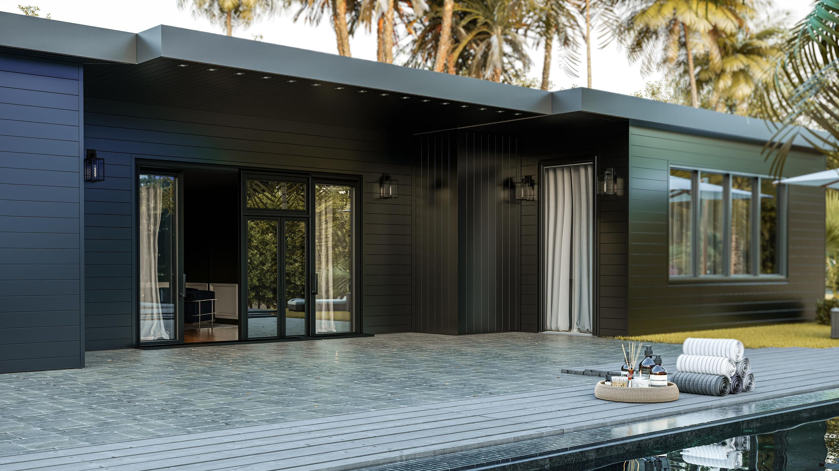
2) A NEW ARCHITECTURAL SKIN
Notes:
Slide 6:
But what if we could just step outside of that compromise all together?
In this next part, we’re going to look at a totally new kind of architectural skin that’s designed to deliver on both of those promises. Beauty AND Performance.

Slide 7
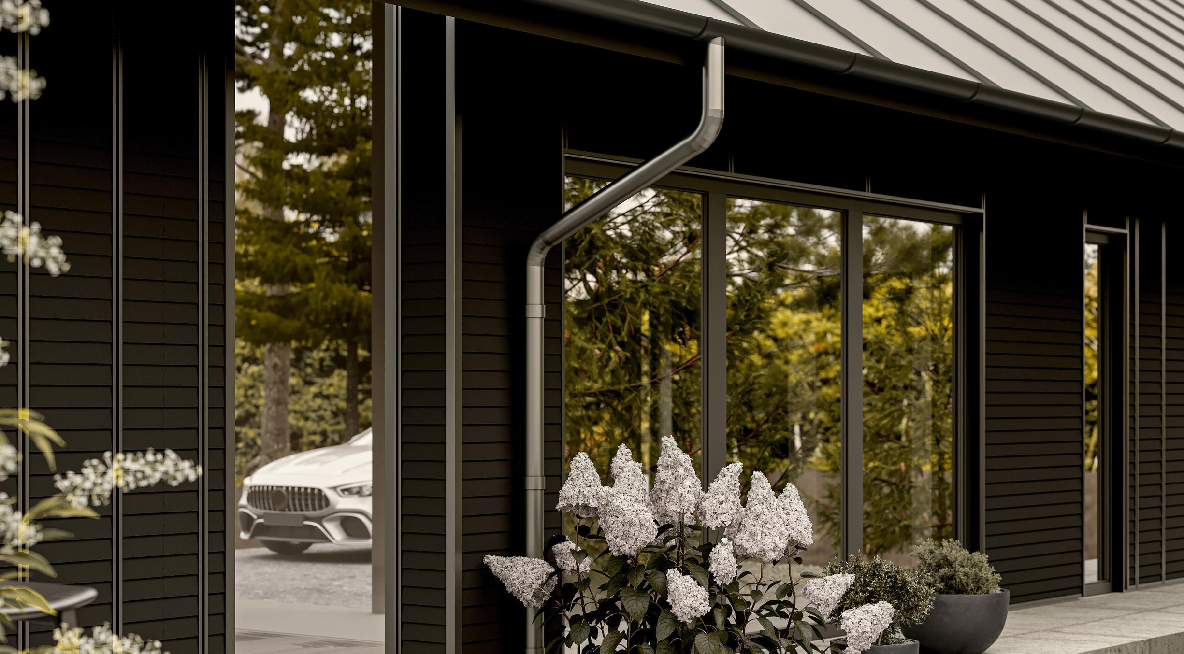
“This isn’t some small improvement; this is a completely new category of material built from the ground up to do things differently.”
Notes:
Slide 7:
I love this quote because it just nails it…
“This isn’t some small improvement; this is a completely new category of material built from the ground up to do things differently.”

Slide 8
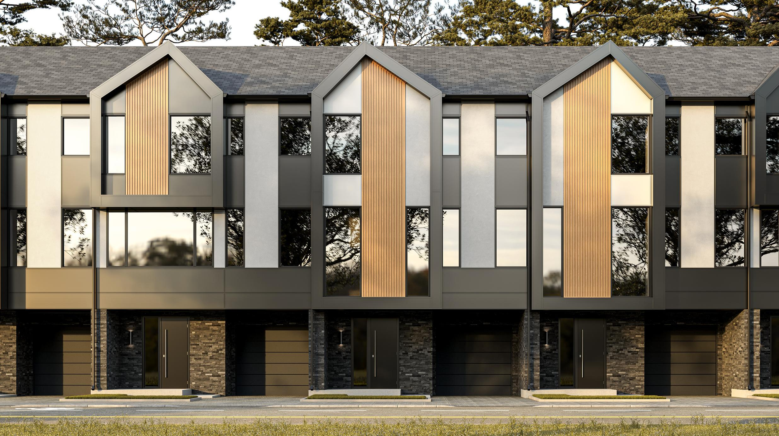
F.E.P.S.
Full Exterior Product Solution
An engineered ecosystem of extruded aluminum profiles with an architectural-grade powder coat finish.
Notes:
Slide 8:
And here it is; It’s called FEPS, Which stands for “Full Exterior Product Solution”.
The key word here is ecosystem. It’s not just one thing, it’s a whole system of parts that work together. All made from three main ingredients – really high grade aluminum, a very special kind of finish, and a clever hidden clip system that ties everything together without the headaches.

Slide 9
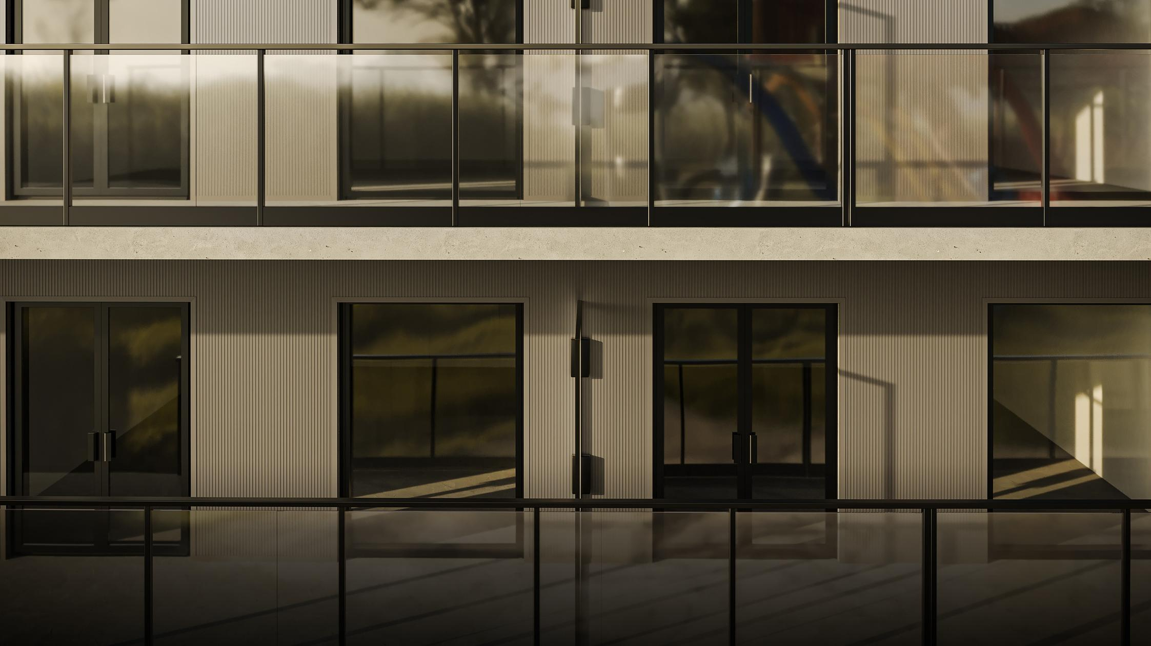
3) THE CORE, THE SHEILD + THE CLIP
Notes:
Slide 9:
Alright, so to really get how this stuff works you gotta break it down into it’s 3 fundamental parts.
There’s the part that gives it it’s shape and it’s strength, there’s the part that gives it it’s color and it’s toughness, and the part that brings it all together—faster, smarter, and more efficiently.
Let’s call them the core, the shield, and the clip.

Slide 10
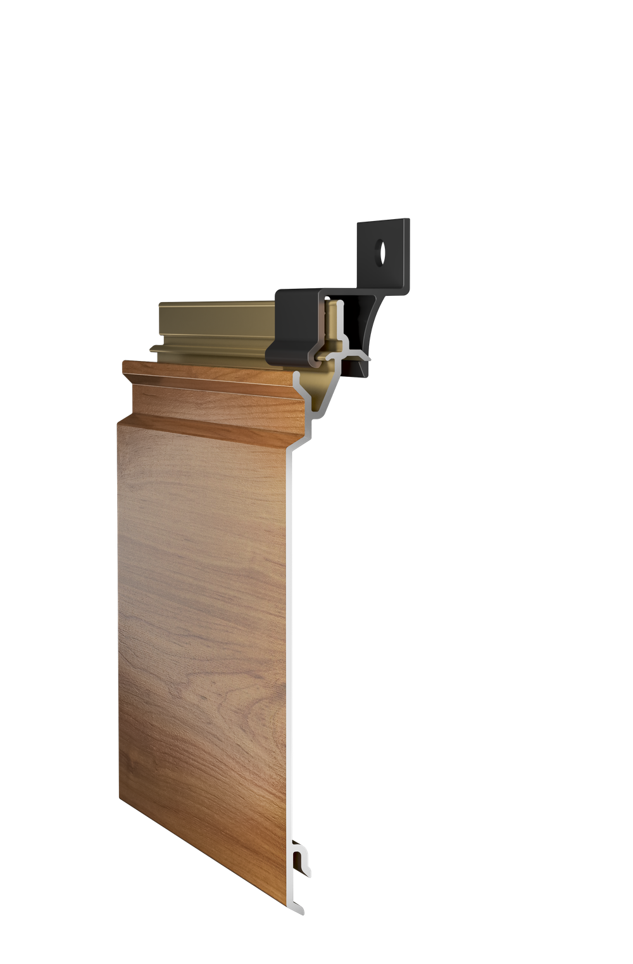
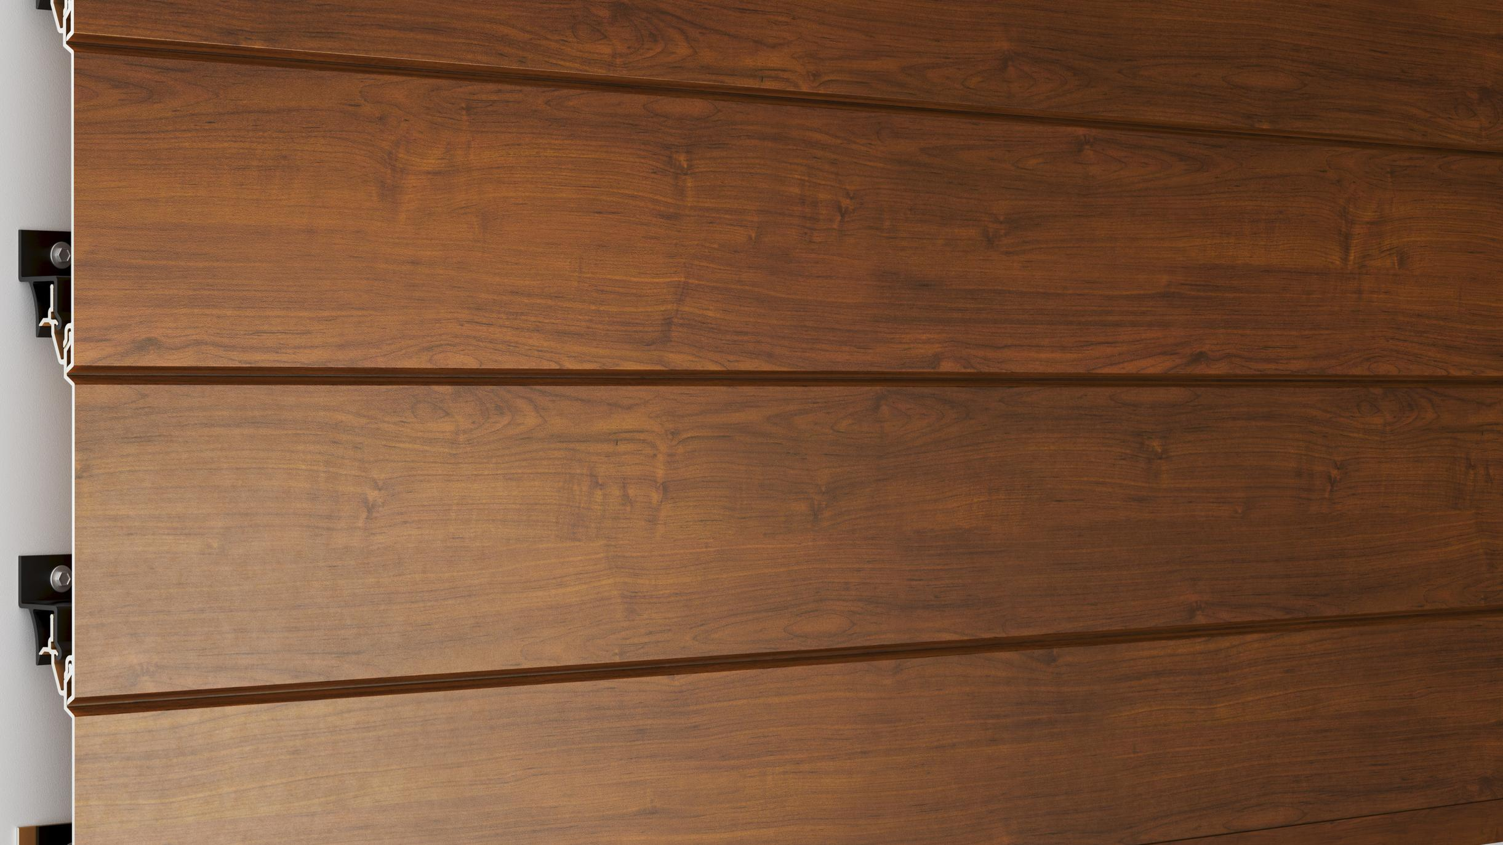

Three Fundamental Parts
The CLIP
efficient installation
The SHEILD
color & toughness
The CORE
shape & strength
Notes:
Slide 10:
Here’s a great visual of how that works.
On the left you’ve got the heart of the system, the aluminum core. That’s the structure.
On the right you have it’s protective layer, the powder coated shield. That’s what gives it the look.
And then at the top you have the clip—the smart little connector that snaps everything into place hidden from view, no visible screws, no fuss, just a clean, fast install that looks pro and holds up for decades.

Slide 11
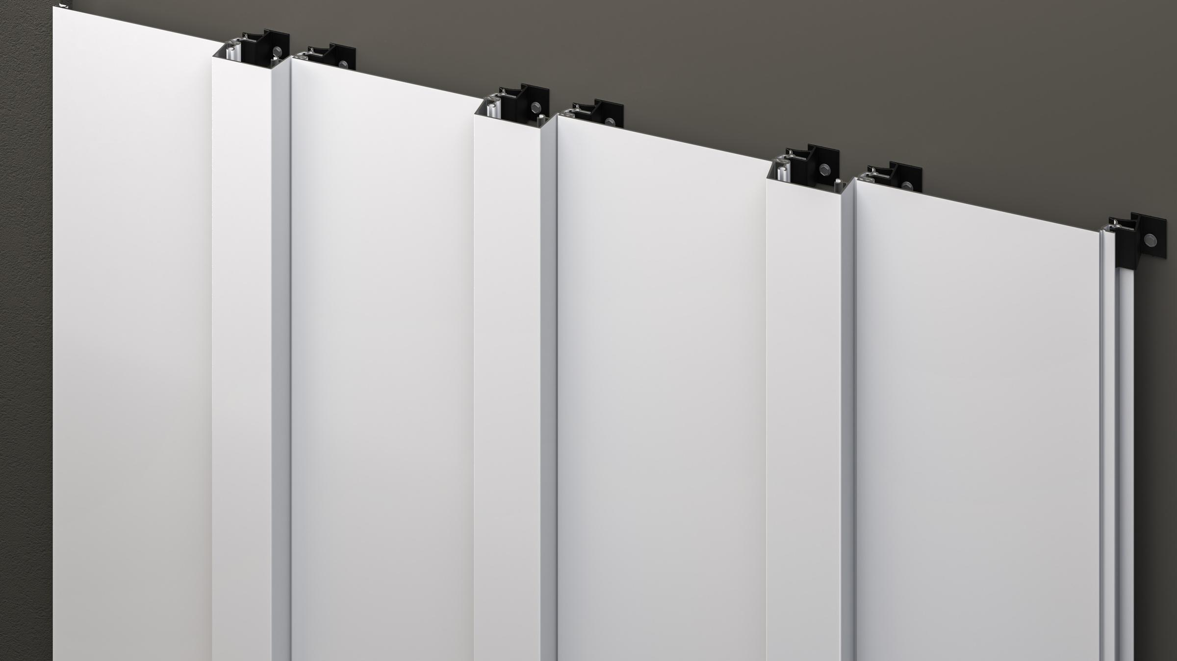
The CORE
Precision extruded aluminum profiles.
Super strong
Won’t warp
Made from 100% recycleable aluminum.
Every piece is made perfectly to fit together flawlessly.
Notes:
Slide 11:
So let’s start with the core. This is the backbone. We’re not just talking about bent pieces of metal here. These are precision extruded aluminum profiles, which means every single piece is made perfectly to fit together flawlessly.
It’s super strong, it won’t warp, and maybe just as important, it’s made from 100% recyclable aluminum.

Slide 12
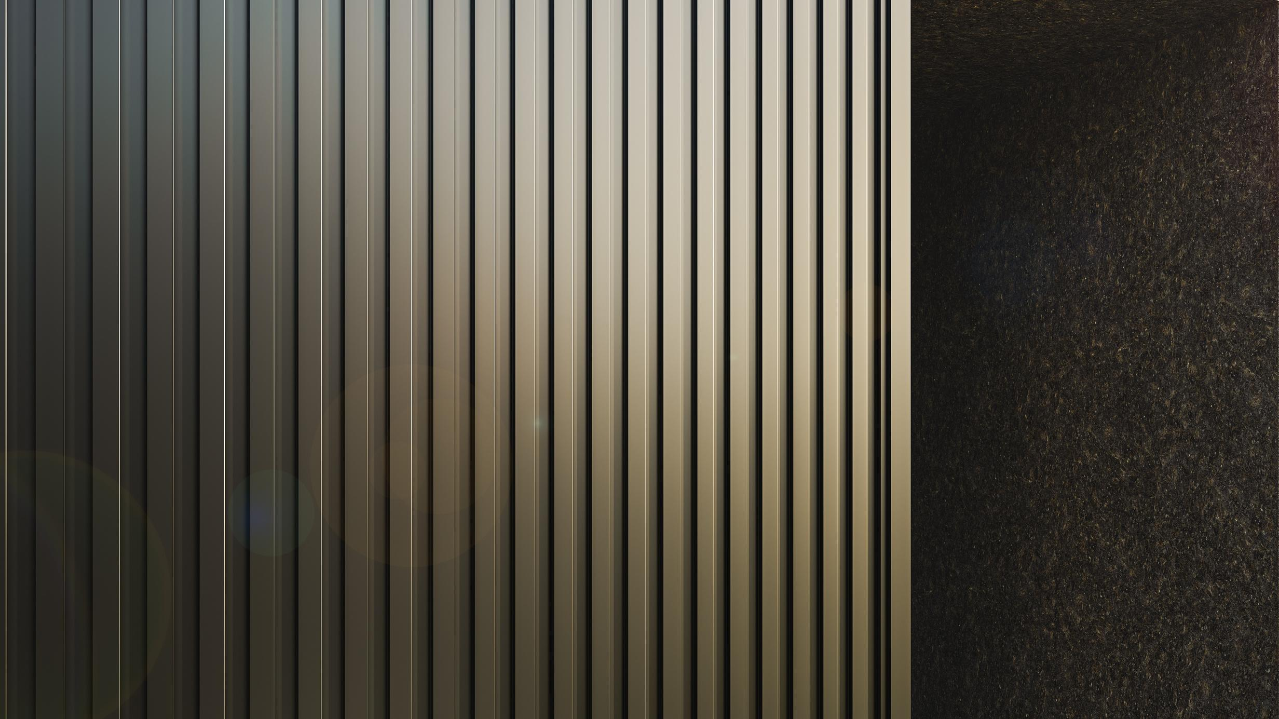
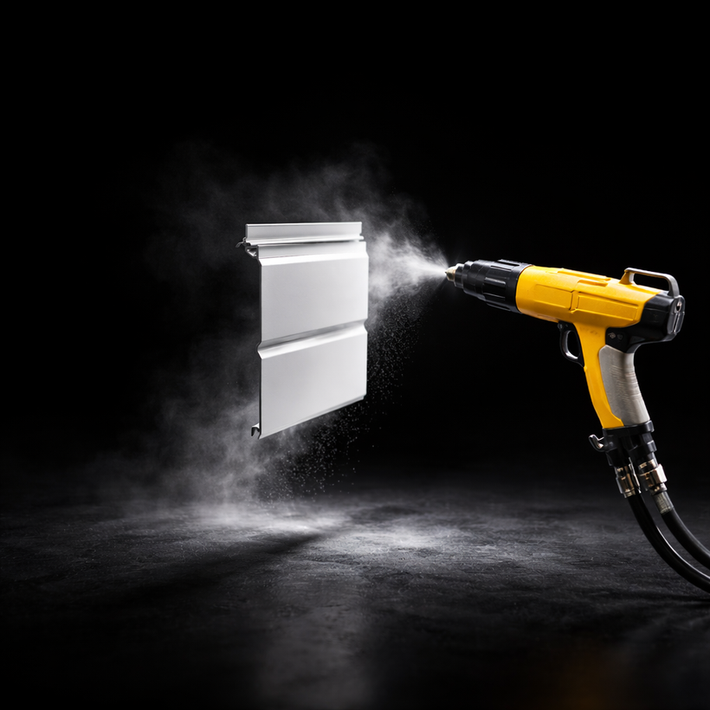
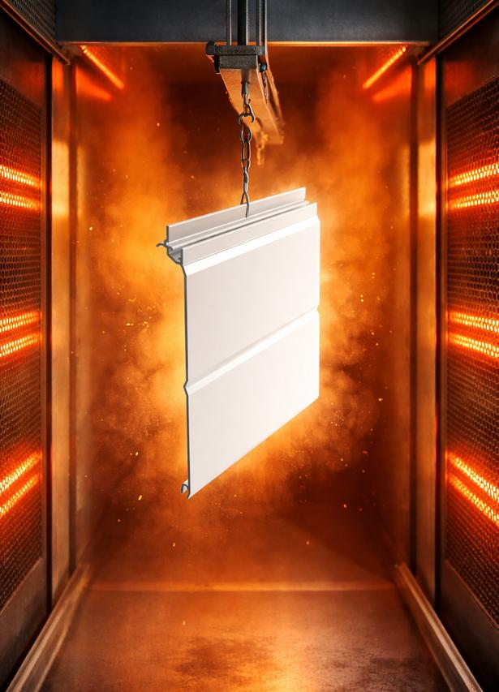
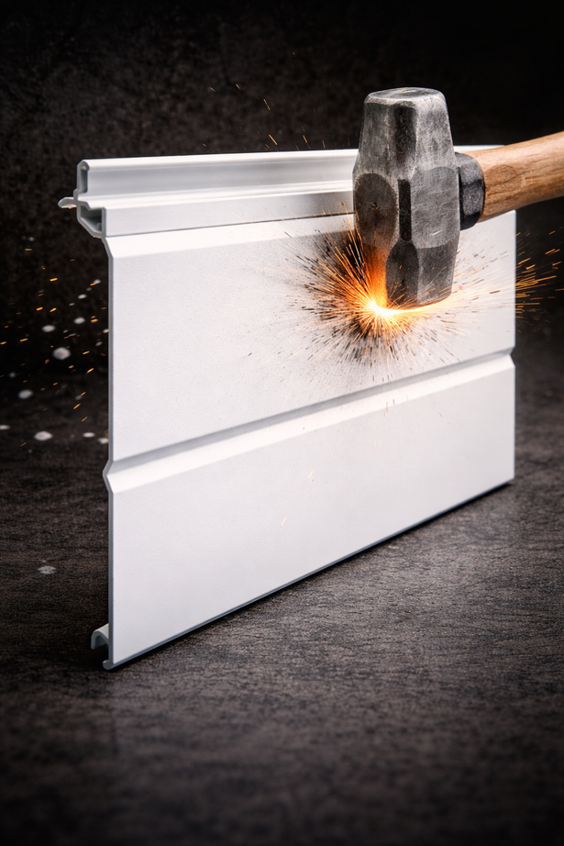
The SHEILD
Premium powder coat.
Electrostatically applied
Baked on
Incredibly tough bond
Designed to look brand new and resist fading for decades with zero maintenance.
Notes:
Slide 12:
Now, if the core is the strength, the shield is where the magic really happens.
It’s a special powder coating that’s electrostatically applied, so it sticks everywhere perfectly. And then baked on in an oven to form this incredibly tough bond.
Think of the finish on a high end bicycle, or a fancy kitchen appliance. It’s designed to look brand new and resist fading for decades, with basically zero maintenance.

Slide 13
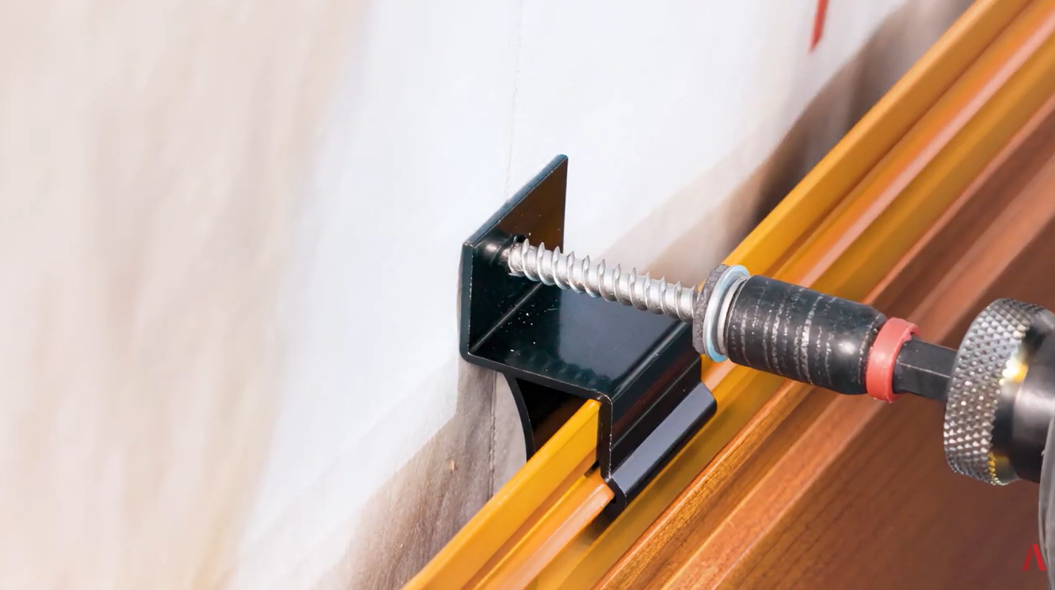
The CLIP
A faster, more intuitive attachment point.
Quick installation
Built-in rainscreen
No caulk or specialized tools required
Installs efficiently while managing moisture effectively.
Notes:
Slide 13:
Now let's talk about the clip—the part that makes the whole ecosystem click (literally). This is our patented Clip & Slide™ system: clever, concealed, and seriously fast.
You snap the clips right onto the top edge of the plank—easy and secure. Then you screw those clips into the subtrate.
It's a true floating wall system, so the planks can expand and contract freely with temperature changes—no buckling, no gapping, just a flat, pro-looking finish that holds up year after year.
No visible screws on the face, no caulk needed between planks, no specialized tools or training. Installs quicker, cuts labor costs, and delivers that clean, modern look crews love and buildings need.

Slide 14
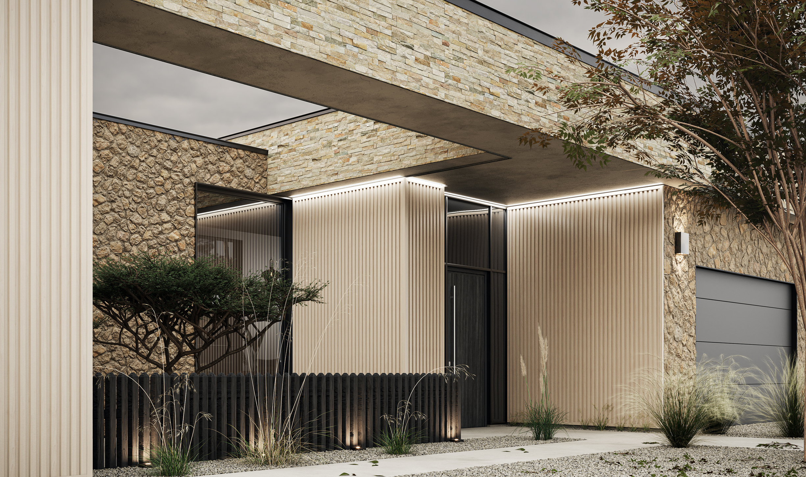
4) LIMITLESS DESIGN
Notes:
Slide 14:
Alright, so we get it – it’s tough, it lasts, and it’s got a lot of engineering behind it. Awesome.
But what about the look? This is where we shift from the science to the art. Because this tech really opens up a whole new world of creative freedom for designers.

Slide 15
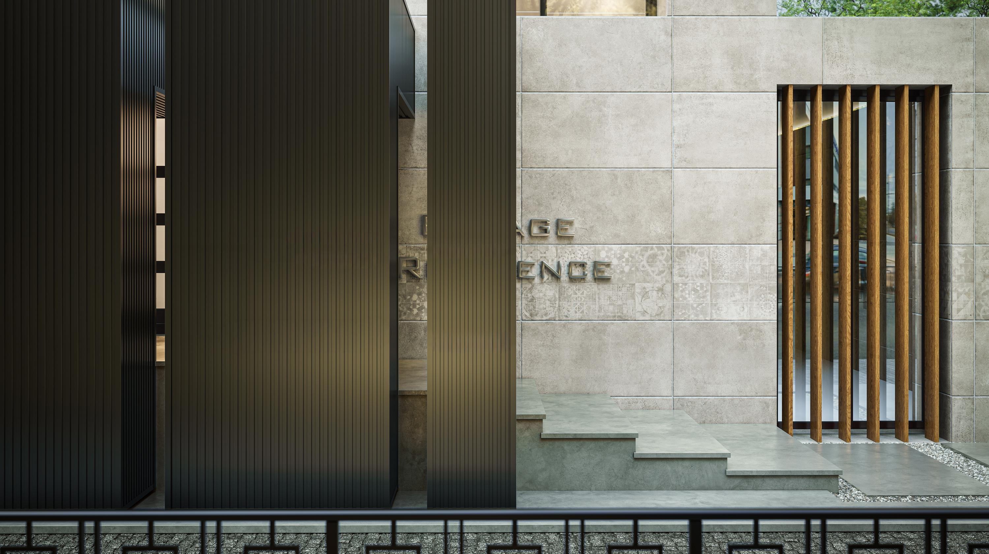
What does architectural freedom look like?
Notes:
Slide 15:
So let’s ask that question: What happens when you take away all those old limits on color and texture, when you don’t have to worry about your material failing you in 10 years?
What does that freedom actually look like?

Slide 16
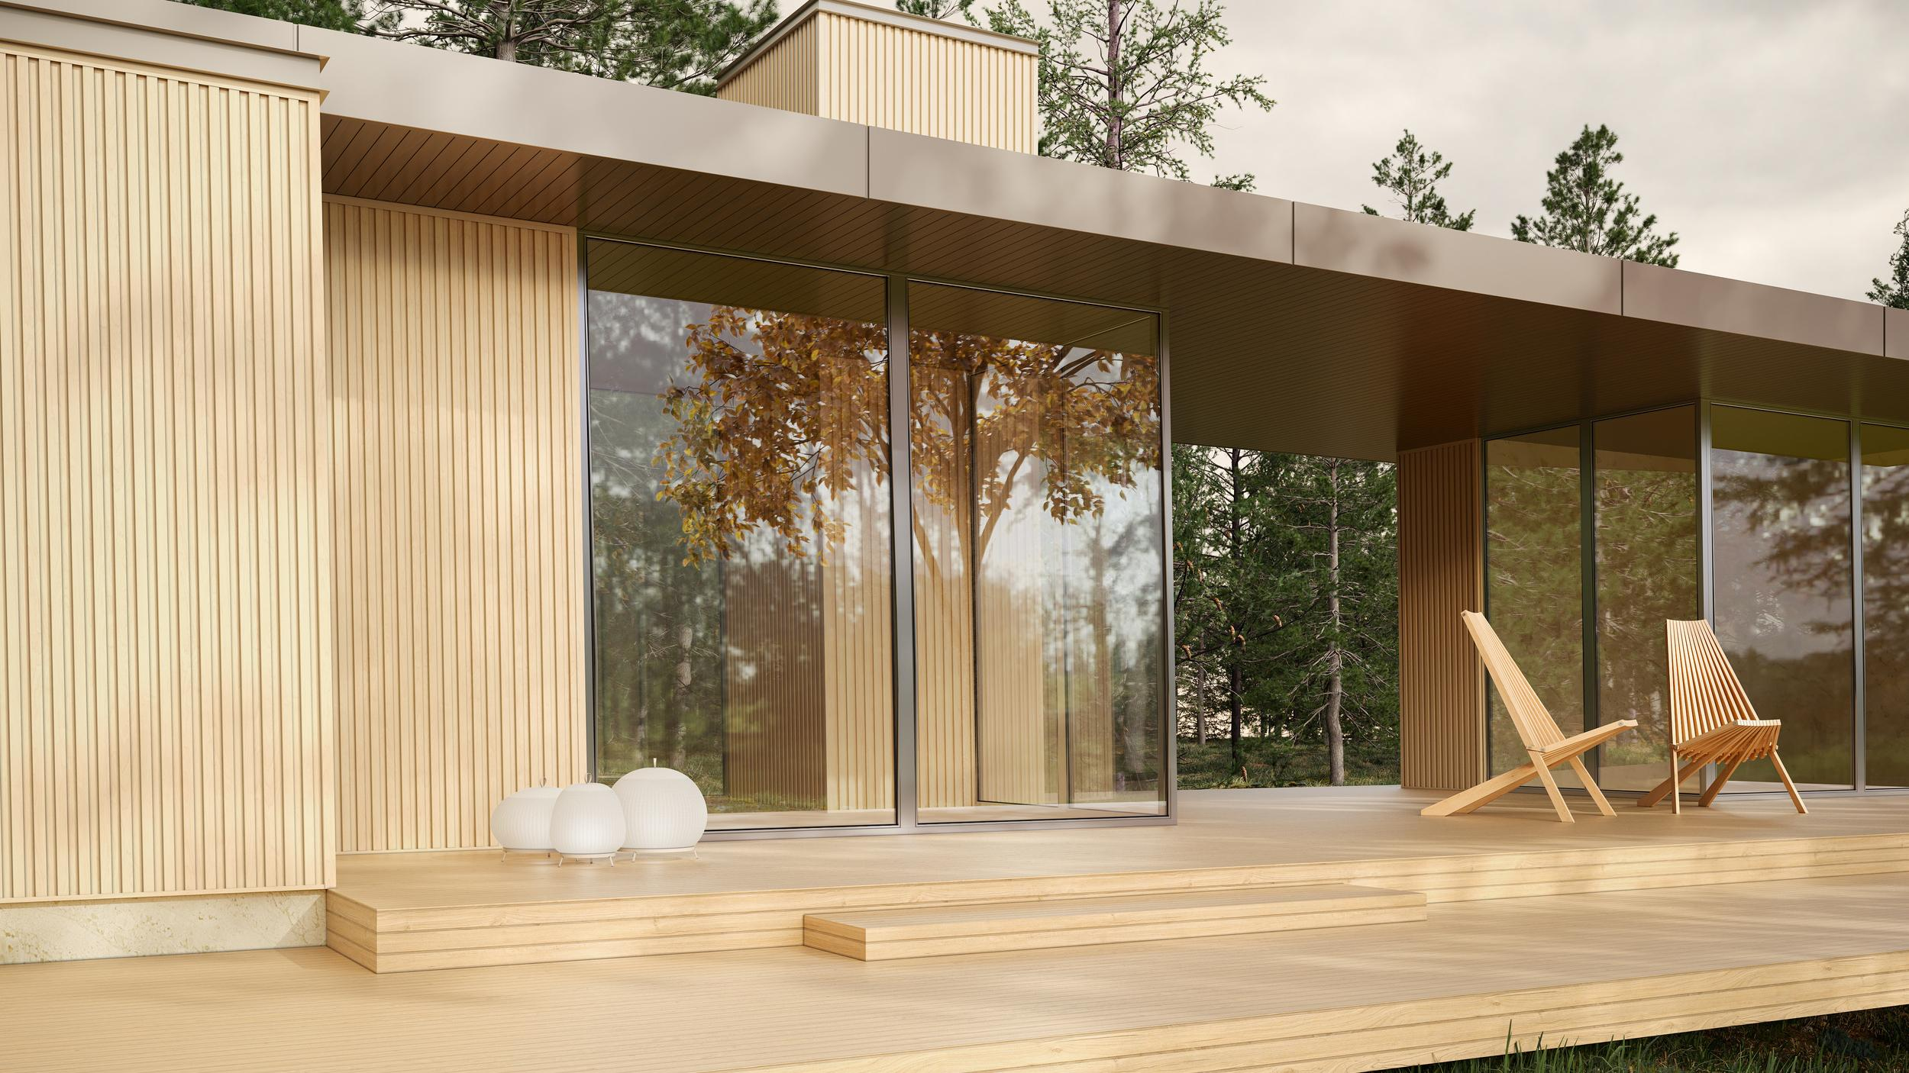
The incredible warm look of wood.
No warping.
No rotting.
No face fasteners.
Notes:
Slide 16:
Well for starters, it means that you can get that incredible warm look of real wood without any of the nightmares. No warping, no rotting… nothing.

Slide 17
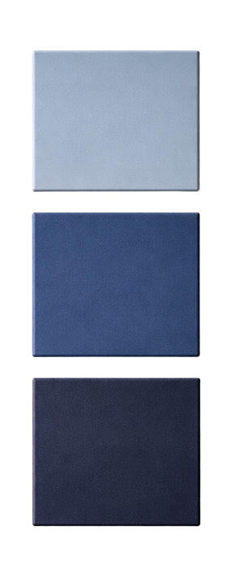
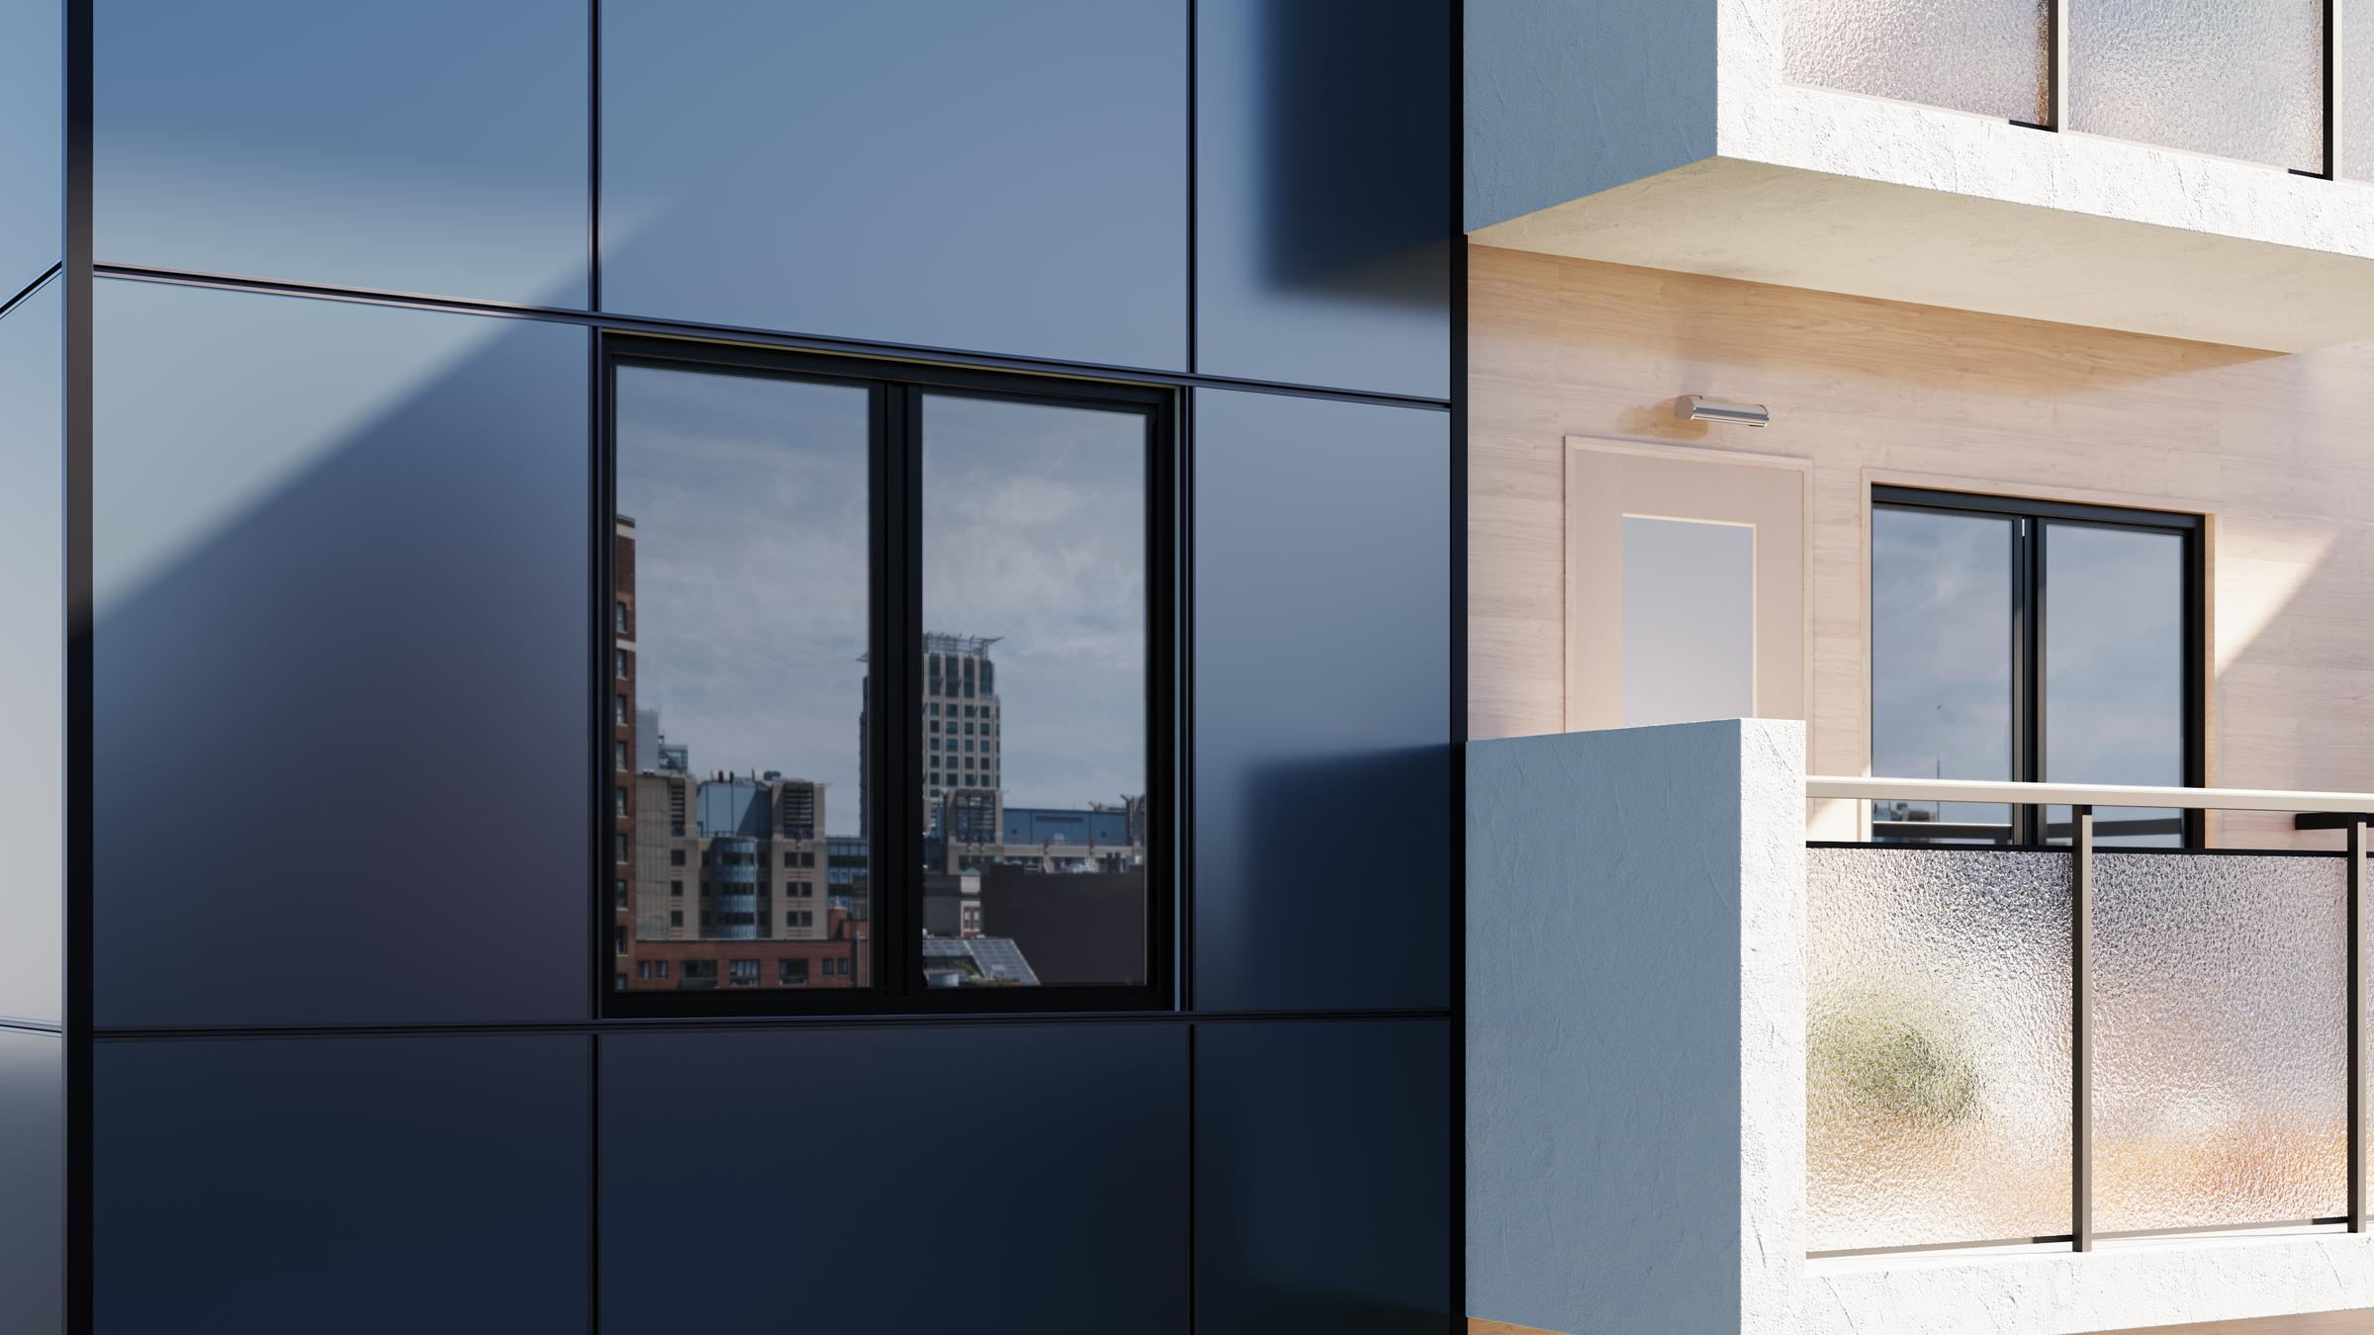
Perfect bold colors that actually stay bold.
No fading,
year after year.
Notes:
Slide 17:
Or, you can go super sleek and modern with these perfect bold colours that actually stay bold. Year after year after year.

Slide 18
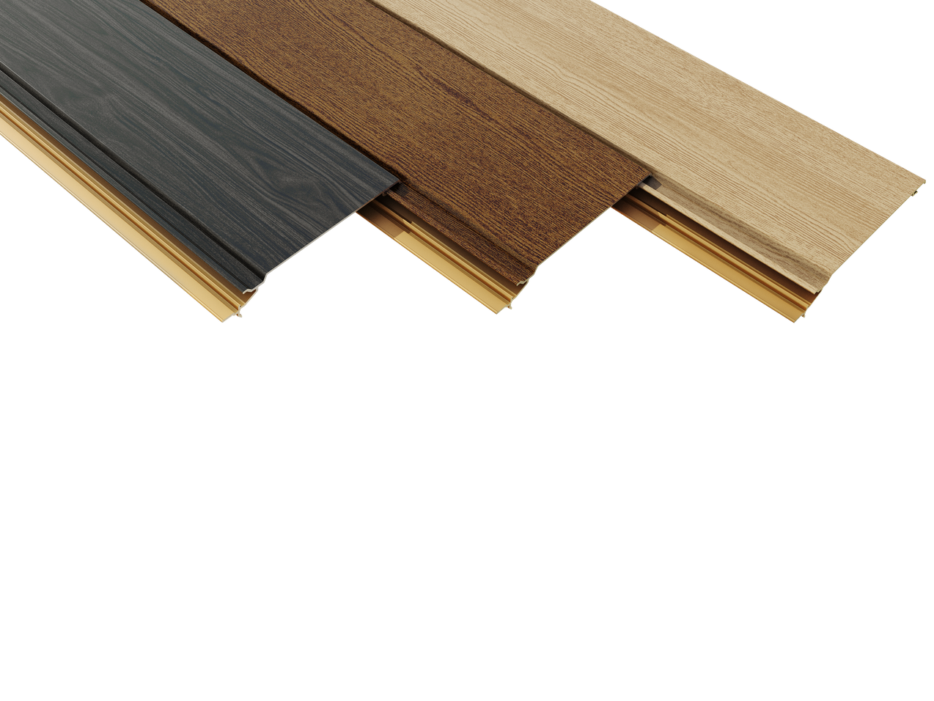
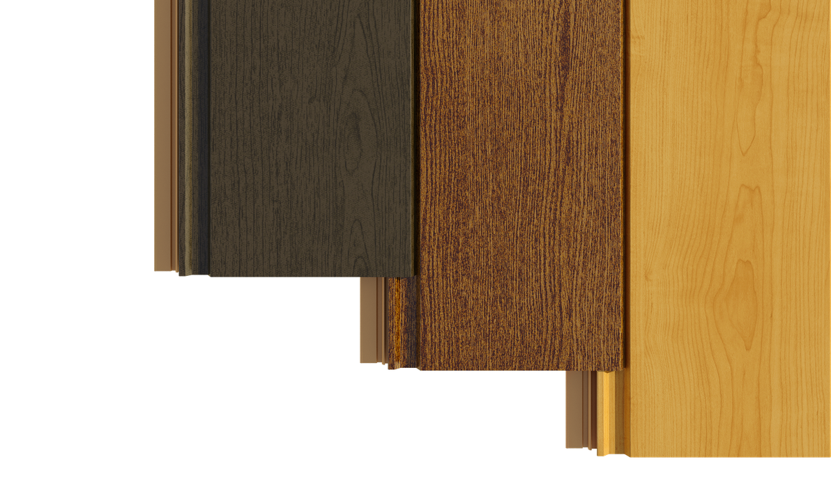
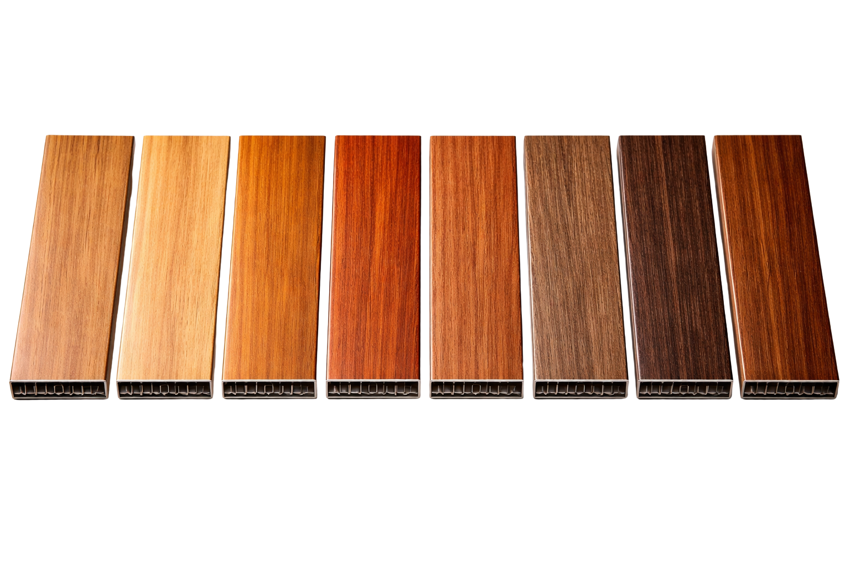
Dozens of woodgrain finishes.
Notes:
Slide 18:
And when we talk about options, the palette is huge. We’re talking dozens of super-realistic woodgrain finishes.

Slide 19
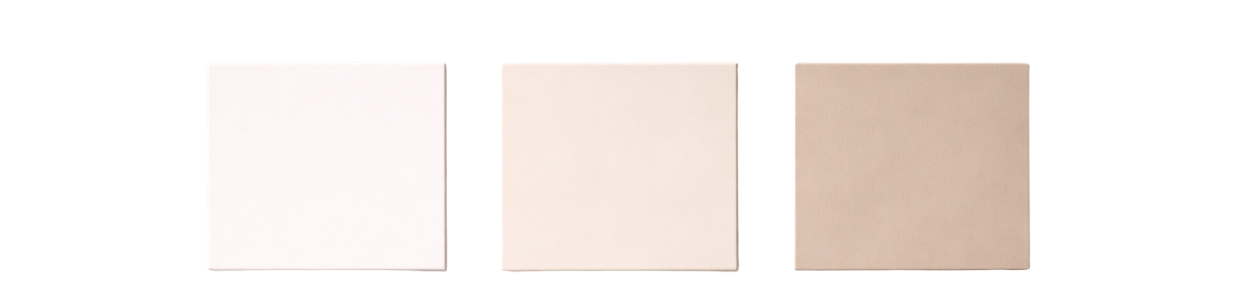
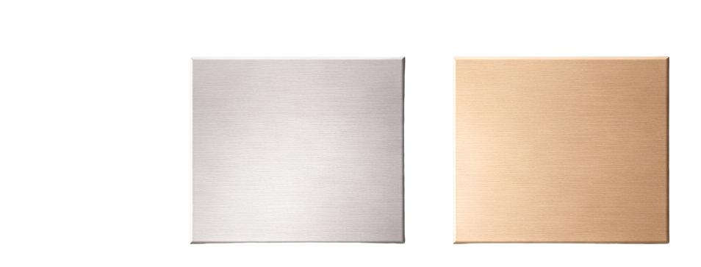
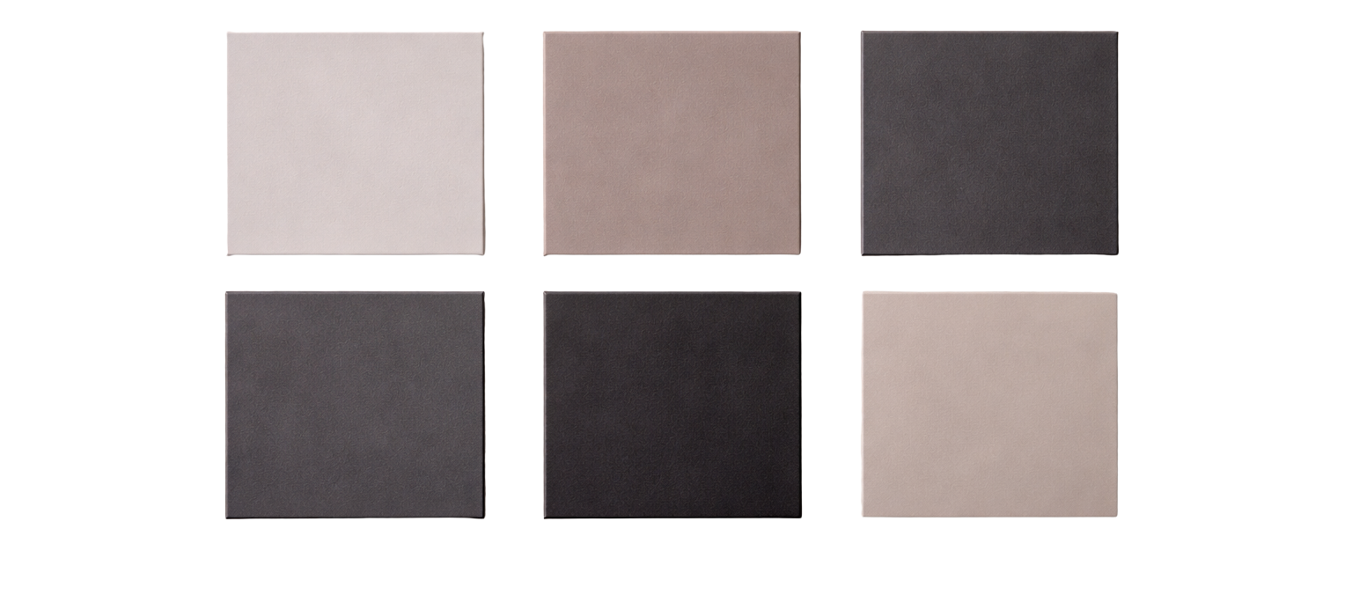
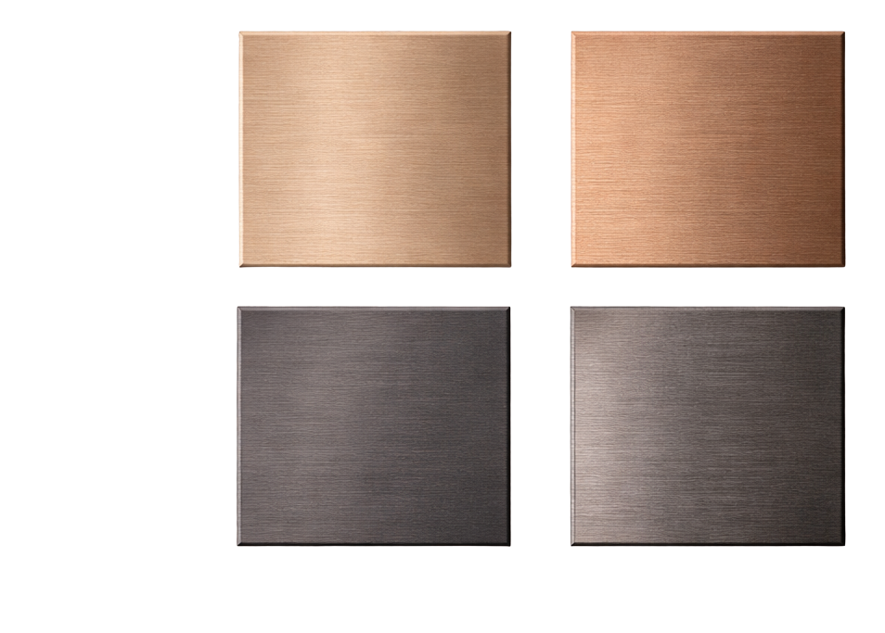
Choose from our curated selection of solids or create your own with ColorMatch™.
Notes:
Slide 19:
If our standard solids aren’t quite hitting the mark, you can custom match virtually any colour an architect can dream up.
The options are - for all intents and purposes - unlimited.

Slide 20
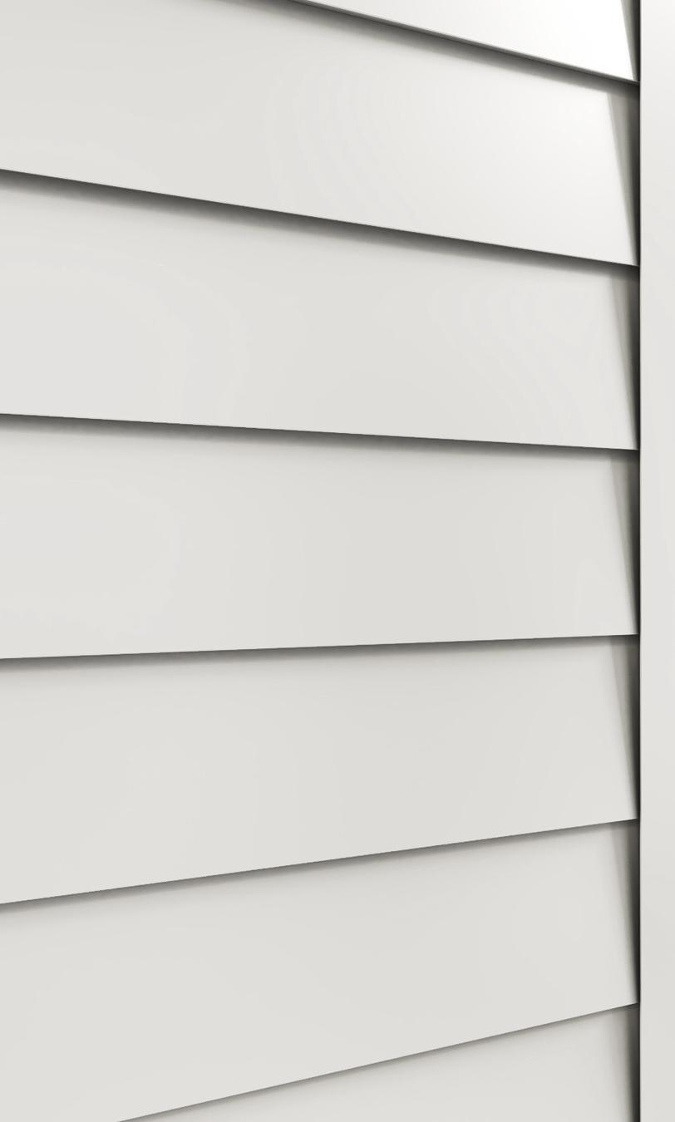
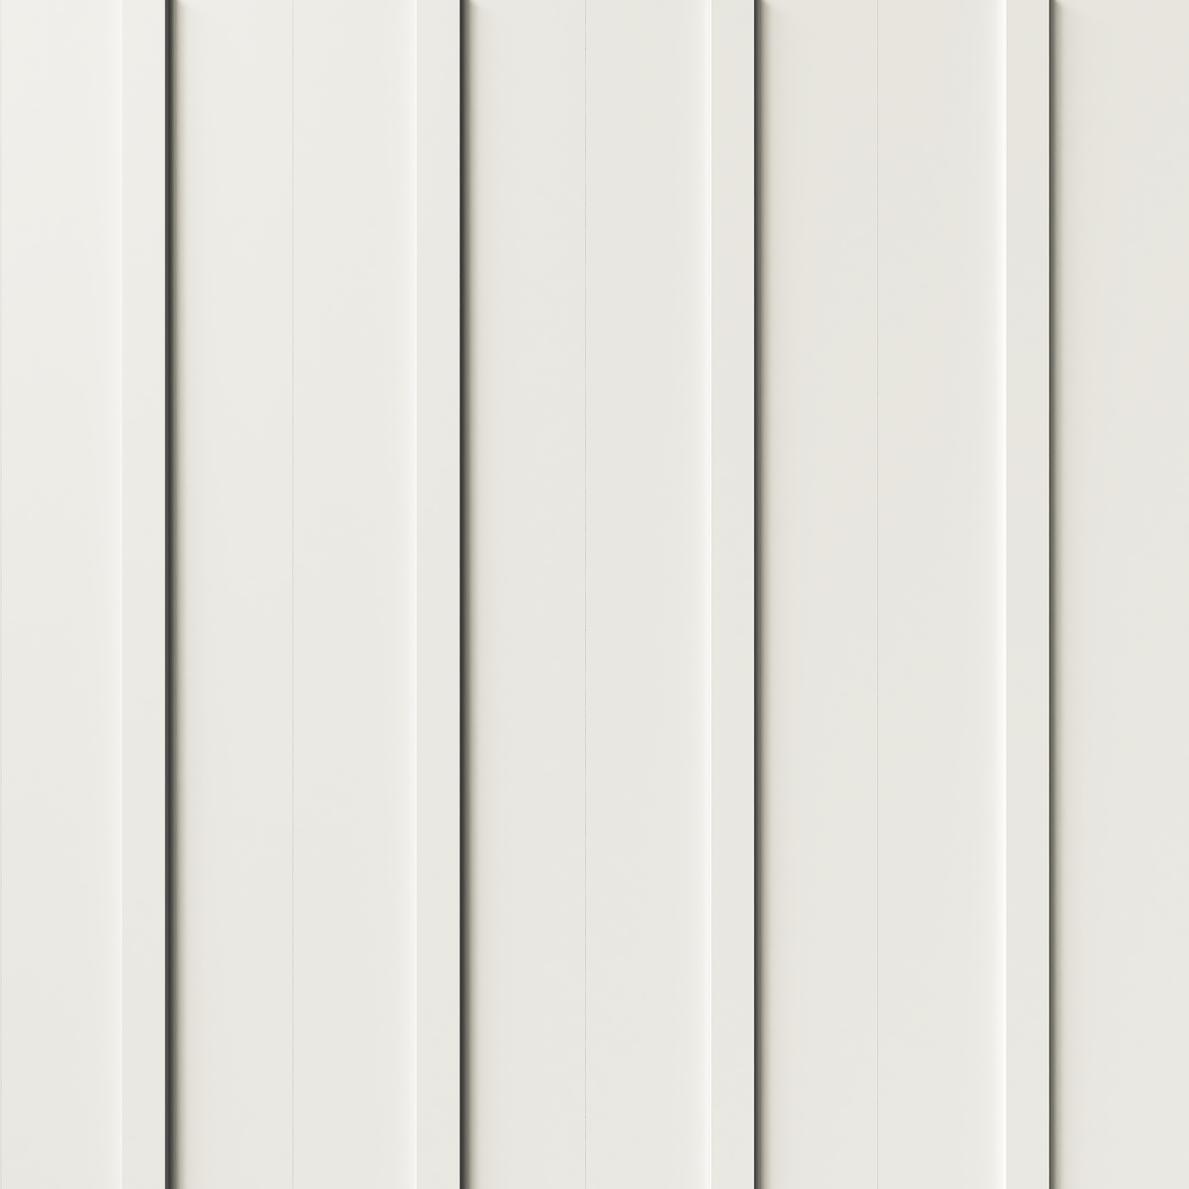

8/16" Lap
Board & Batten
Shallow Fluted
Notes:
But here’s the real game changer- all these different styles, whether you want that classic lap siding look, or board and batten...

Slide 21
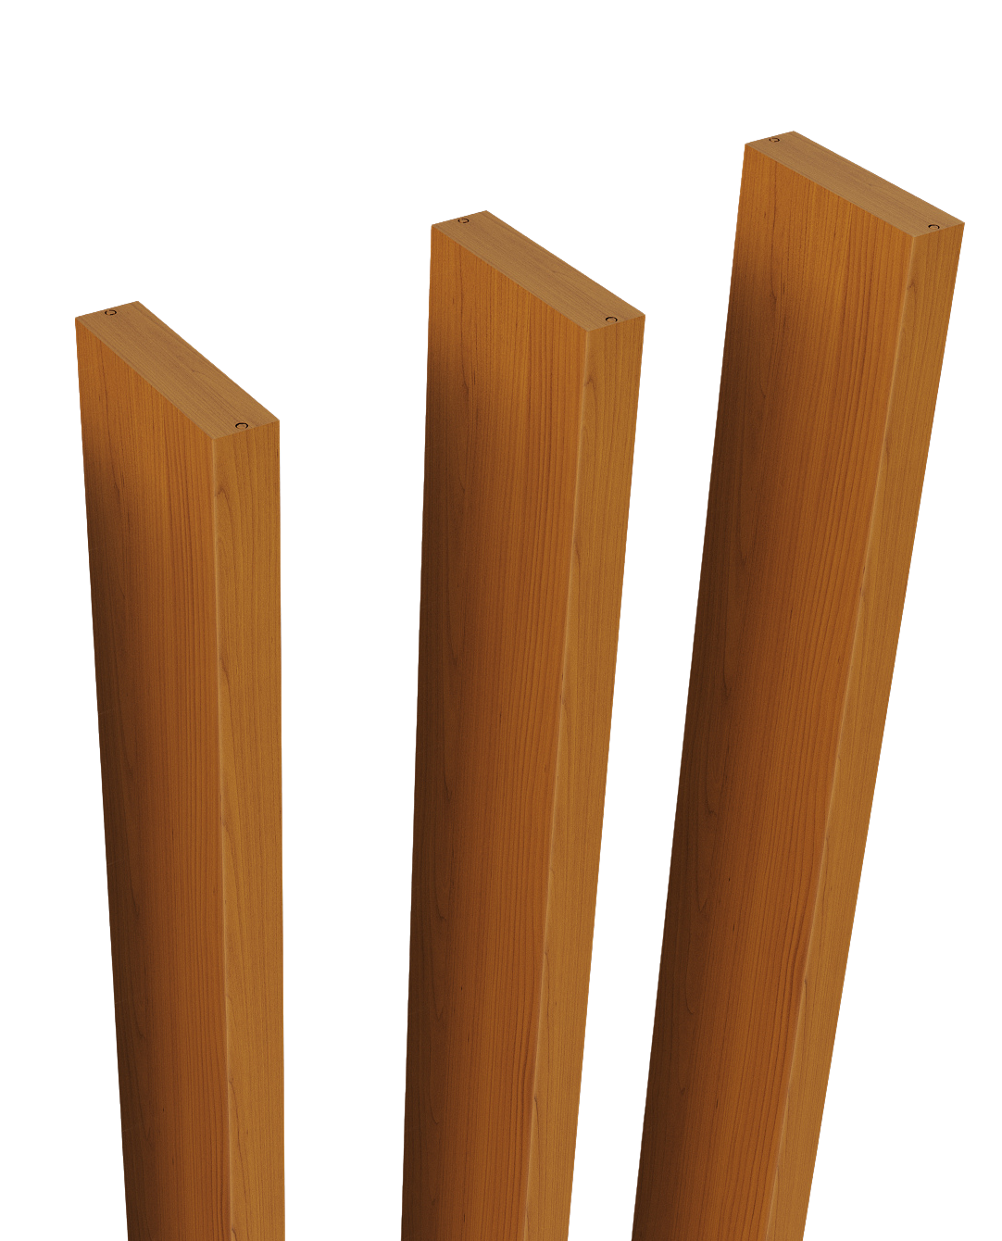
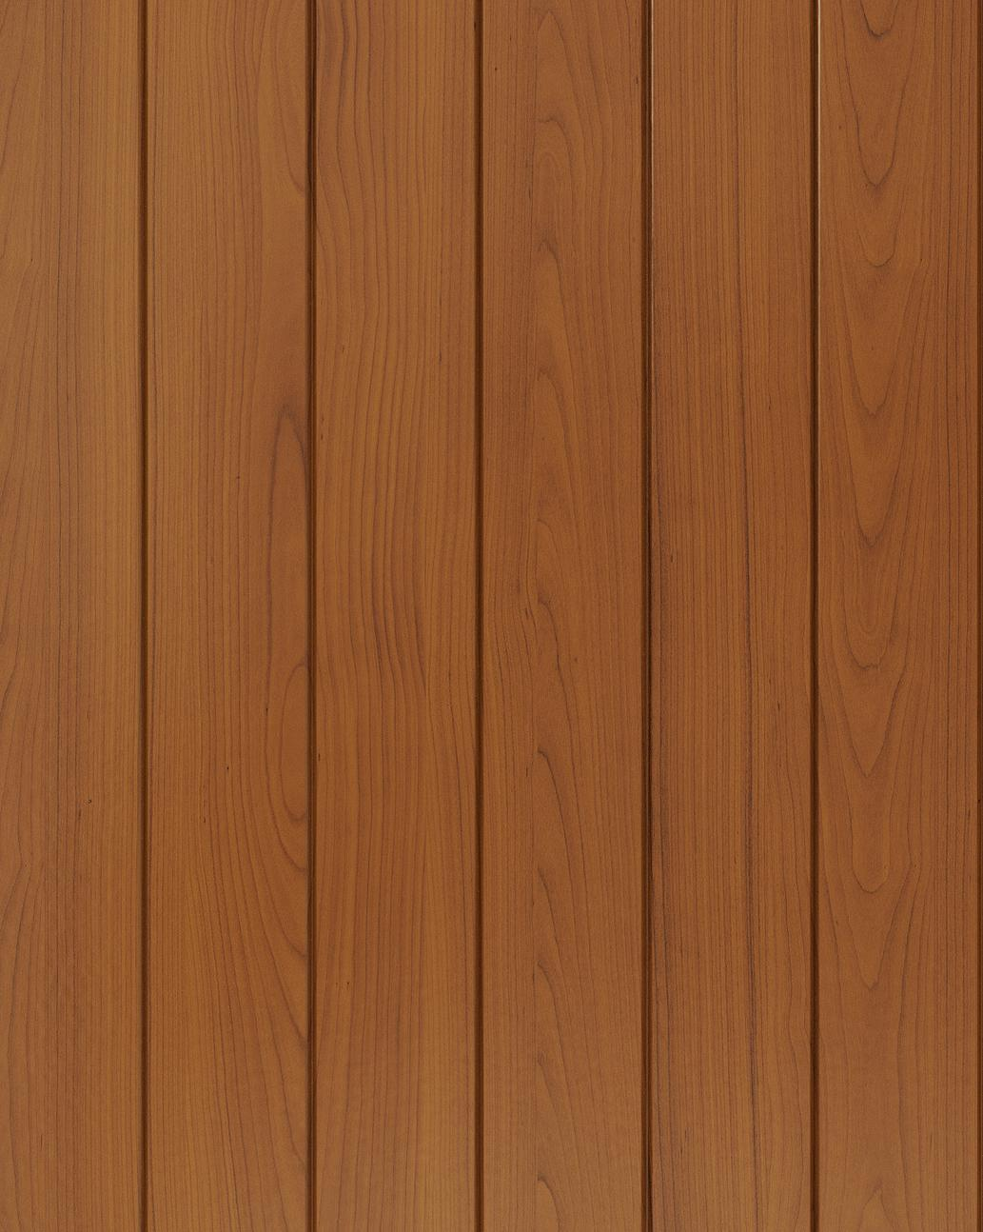
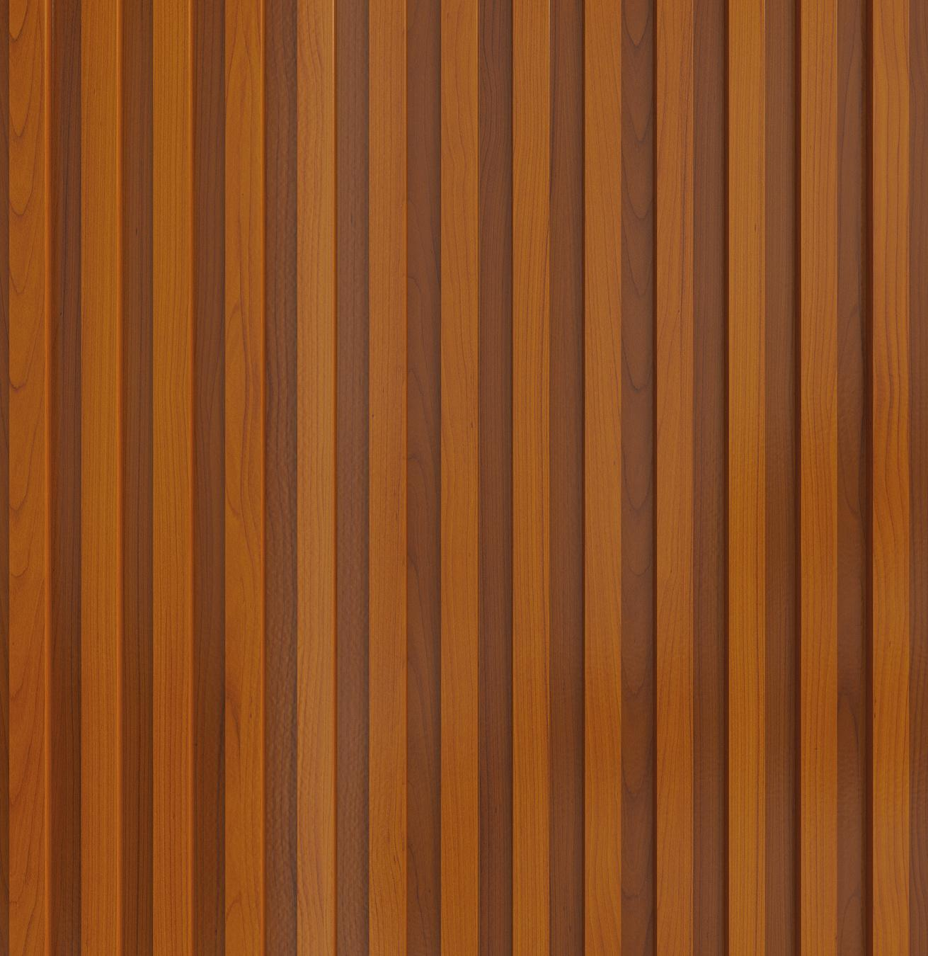
3" Double V-Notch
Architectural Fins
Deep Fluted
Notes:
or these really cool modern fins...

Slide 22
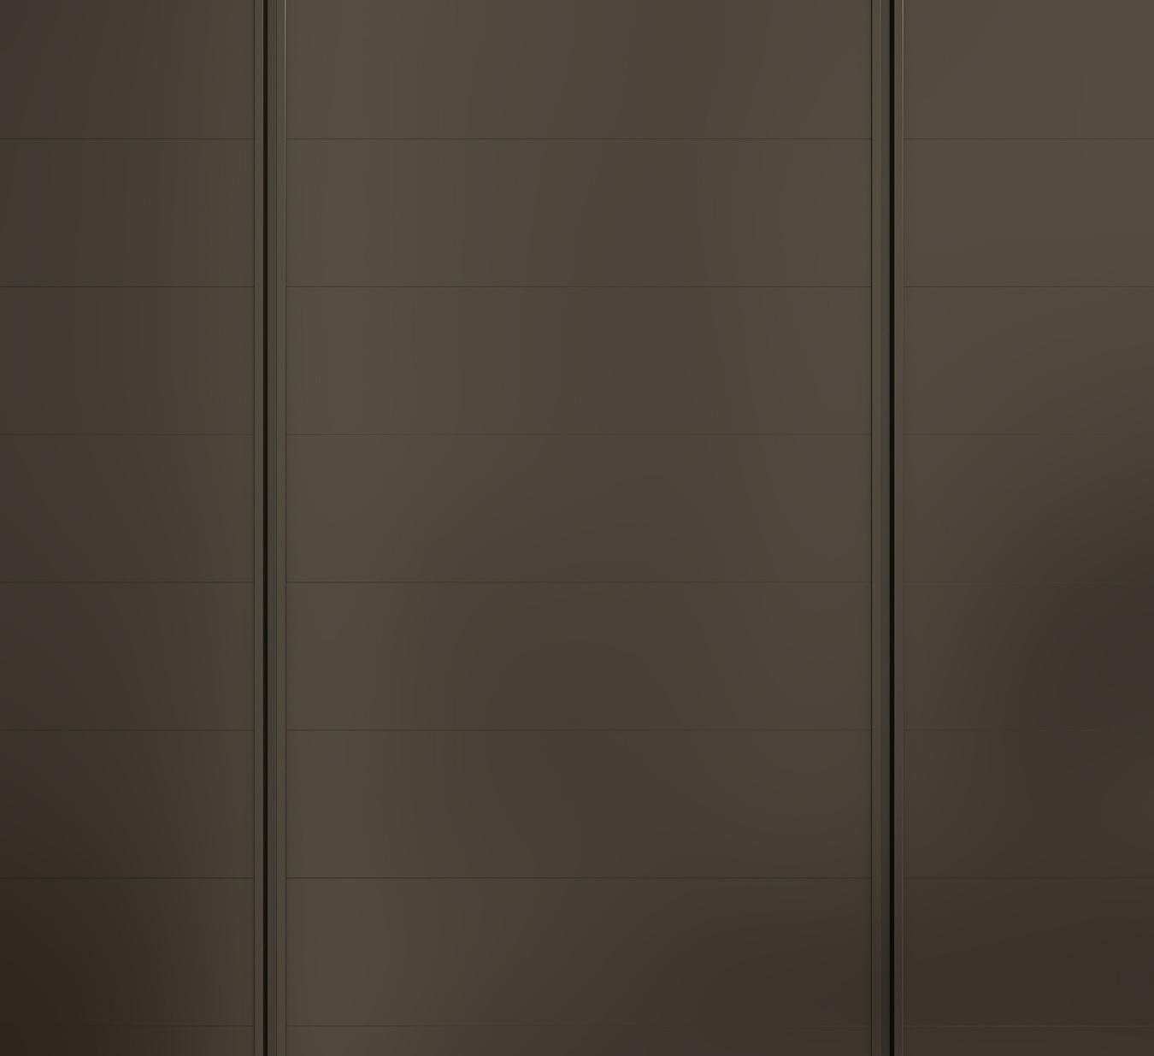

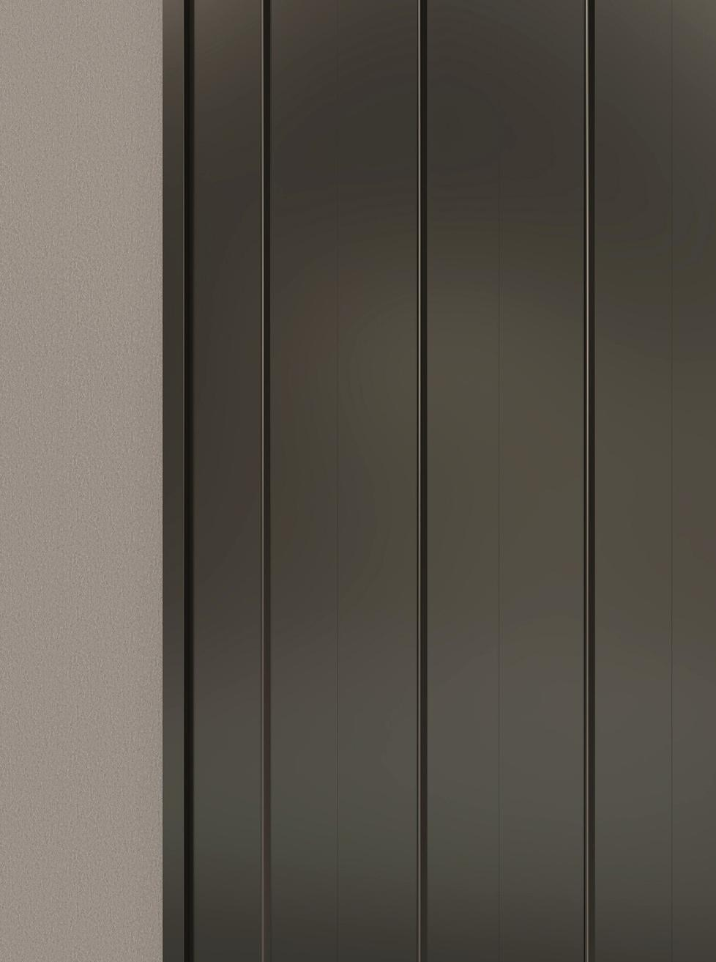
Invisi-Line with Reveals
Variable Square Notch
Standing Seam
Notes:
they’re all designed as part of one single system.

Slide 23
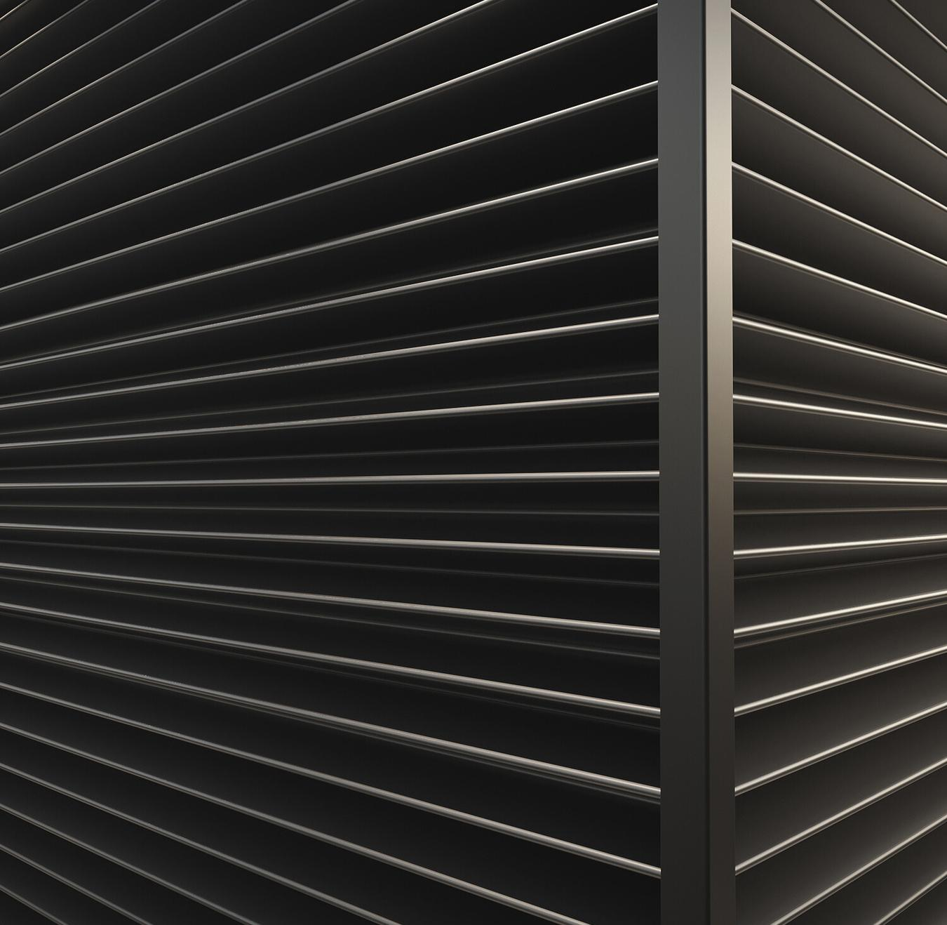

Chevron
6" V-Notch
Notes:
You can mix and match them on the same building...

Slide 24
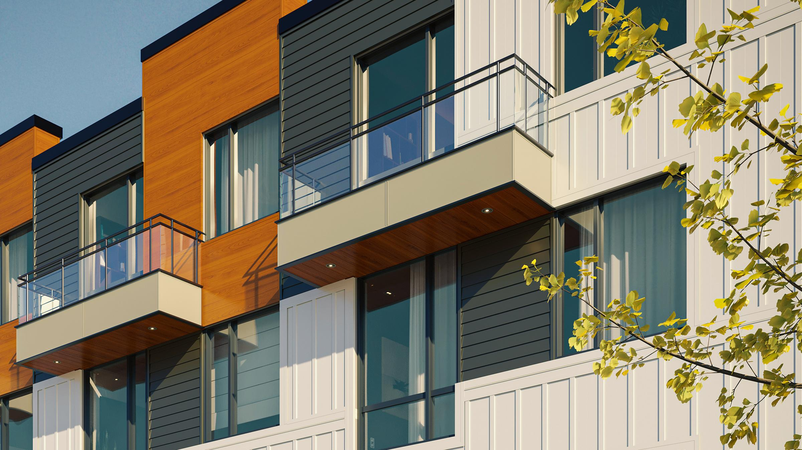
All these different styles are designed as part of one single system.
Notes:
and it all just works.

Slide 25
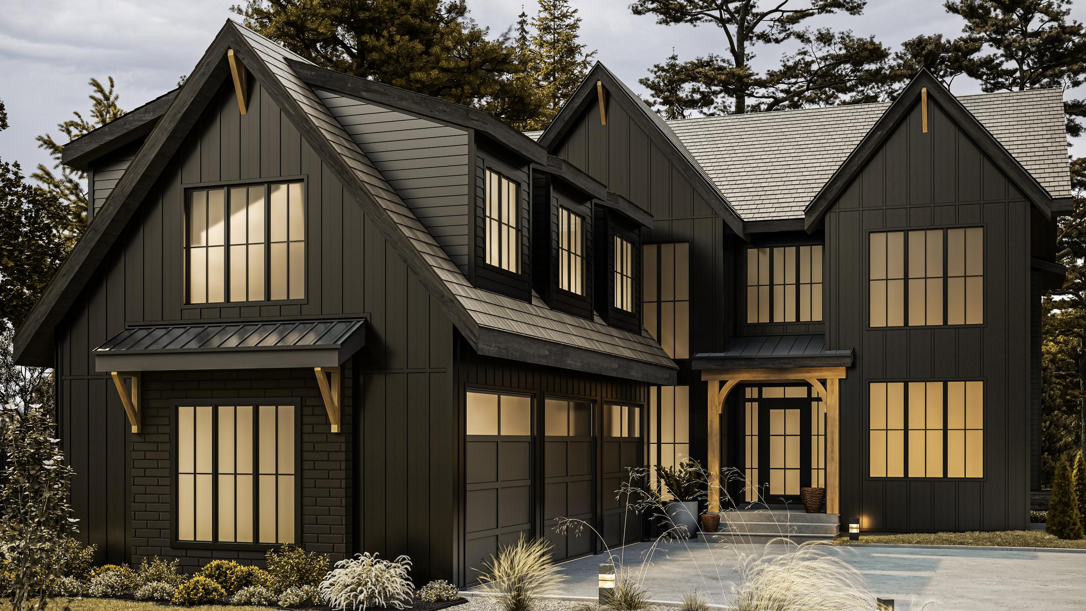
Go for a timeless, classic look.
Lap + Board & Batten
Notes:
So you could go for a super classic, timeless look like this lap with board and batten here.
Those shadow lines are perfect and they’re going to stay perfect, unlike wood that can shrink and gap over time.

Slide 26
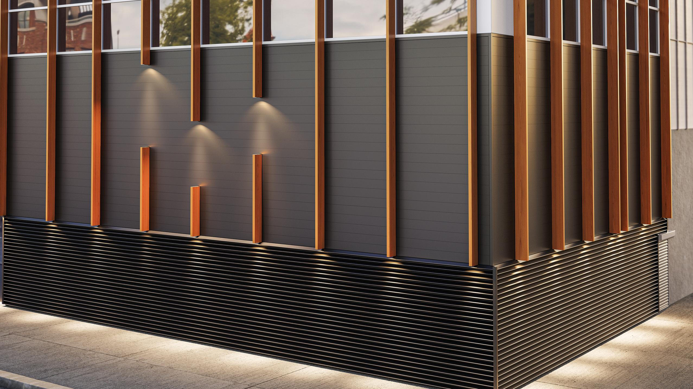
Or go in a completely new direction, go modern.
Architectural Fins + Chevron
Notes:
Or you could go in a completely different direction, go modern with Architectural fins and Chevron.
And you get all of that beauty with the permanence of aluminum.

Slide 27
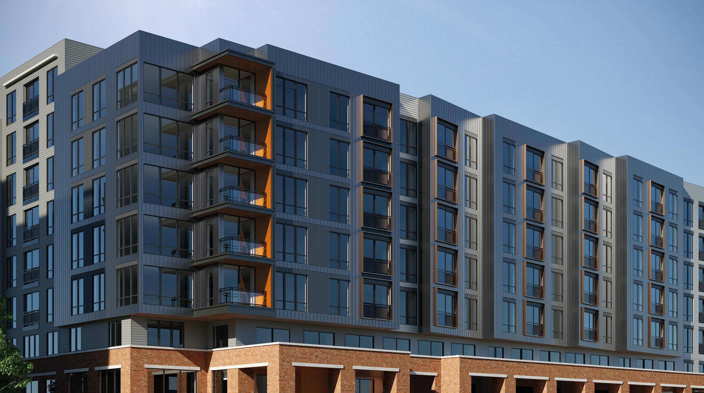
“Where this system really shines is on big projects. It lets architects get really creative – mixing different colors and textures to create buildings that are super interesting to look at, but are also incredibly efficient to build and maintain.”
Notes:
Slide 23:
Where this system really shines is on big projects. It lets architects get really creative – mixing different colors and textures to create buildings that are super interesting to look at, but are also incredibly efficient to build and maintain.

Slide 28
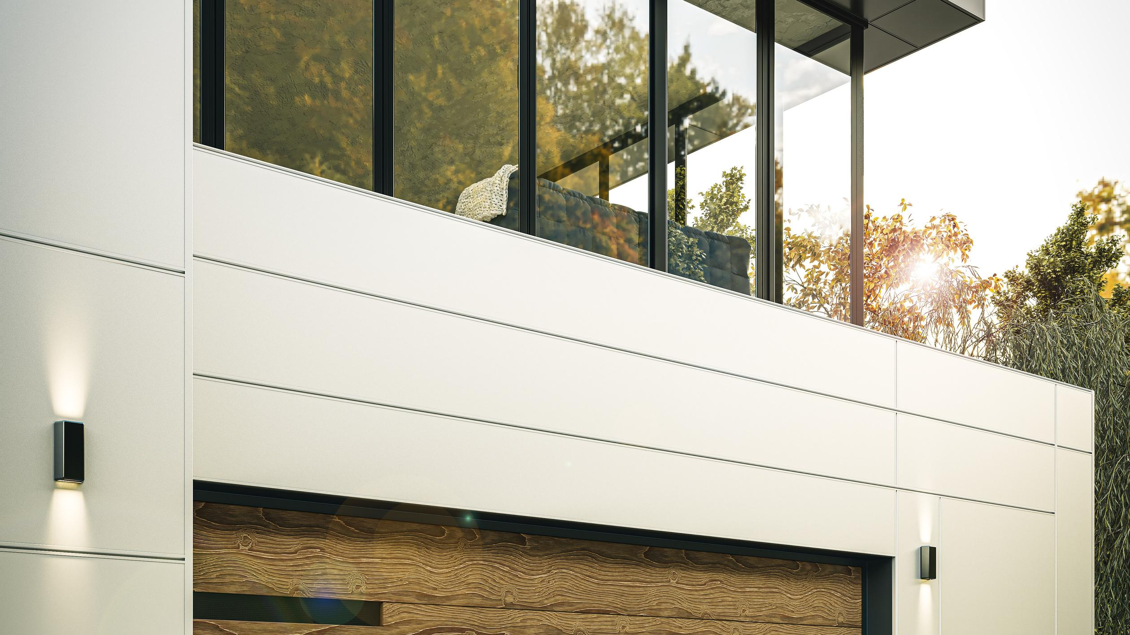
5) BUILT FOR THE FUTURE
Notes:
Slide 24:
You know, at the end of the day, this is about more than just a new building material, it’s a totally different way of thinking about construction. It’s looking at the entire life of a building. From the day the materials are specified to it’s long term value.

Slide 29
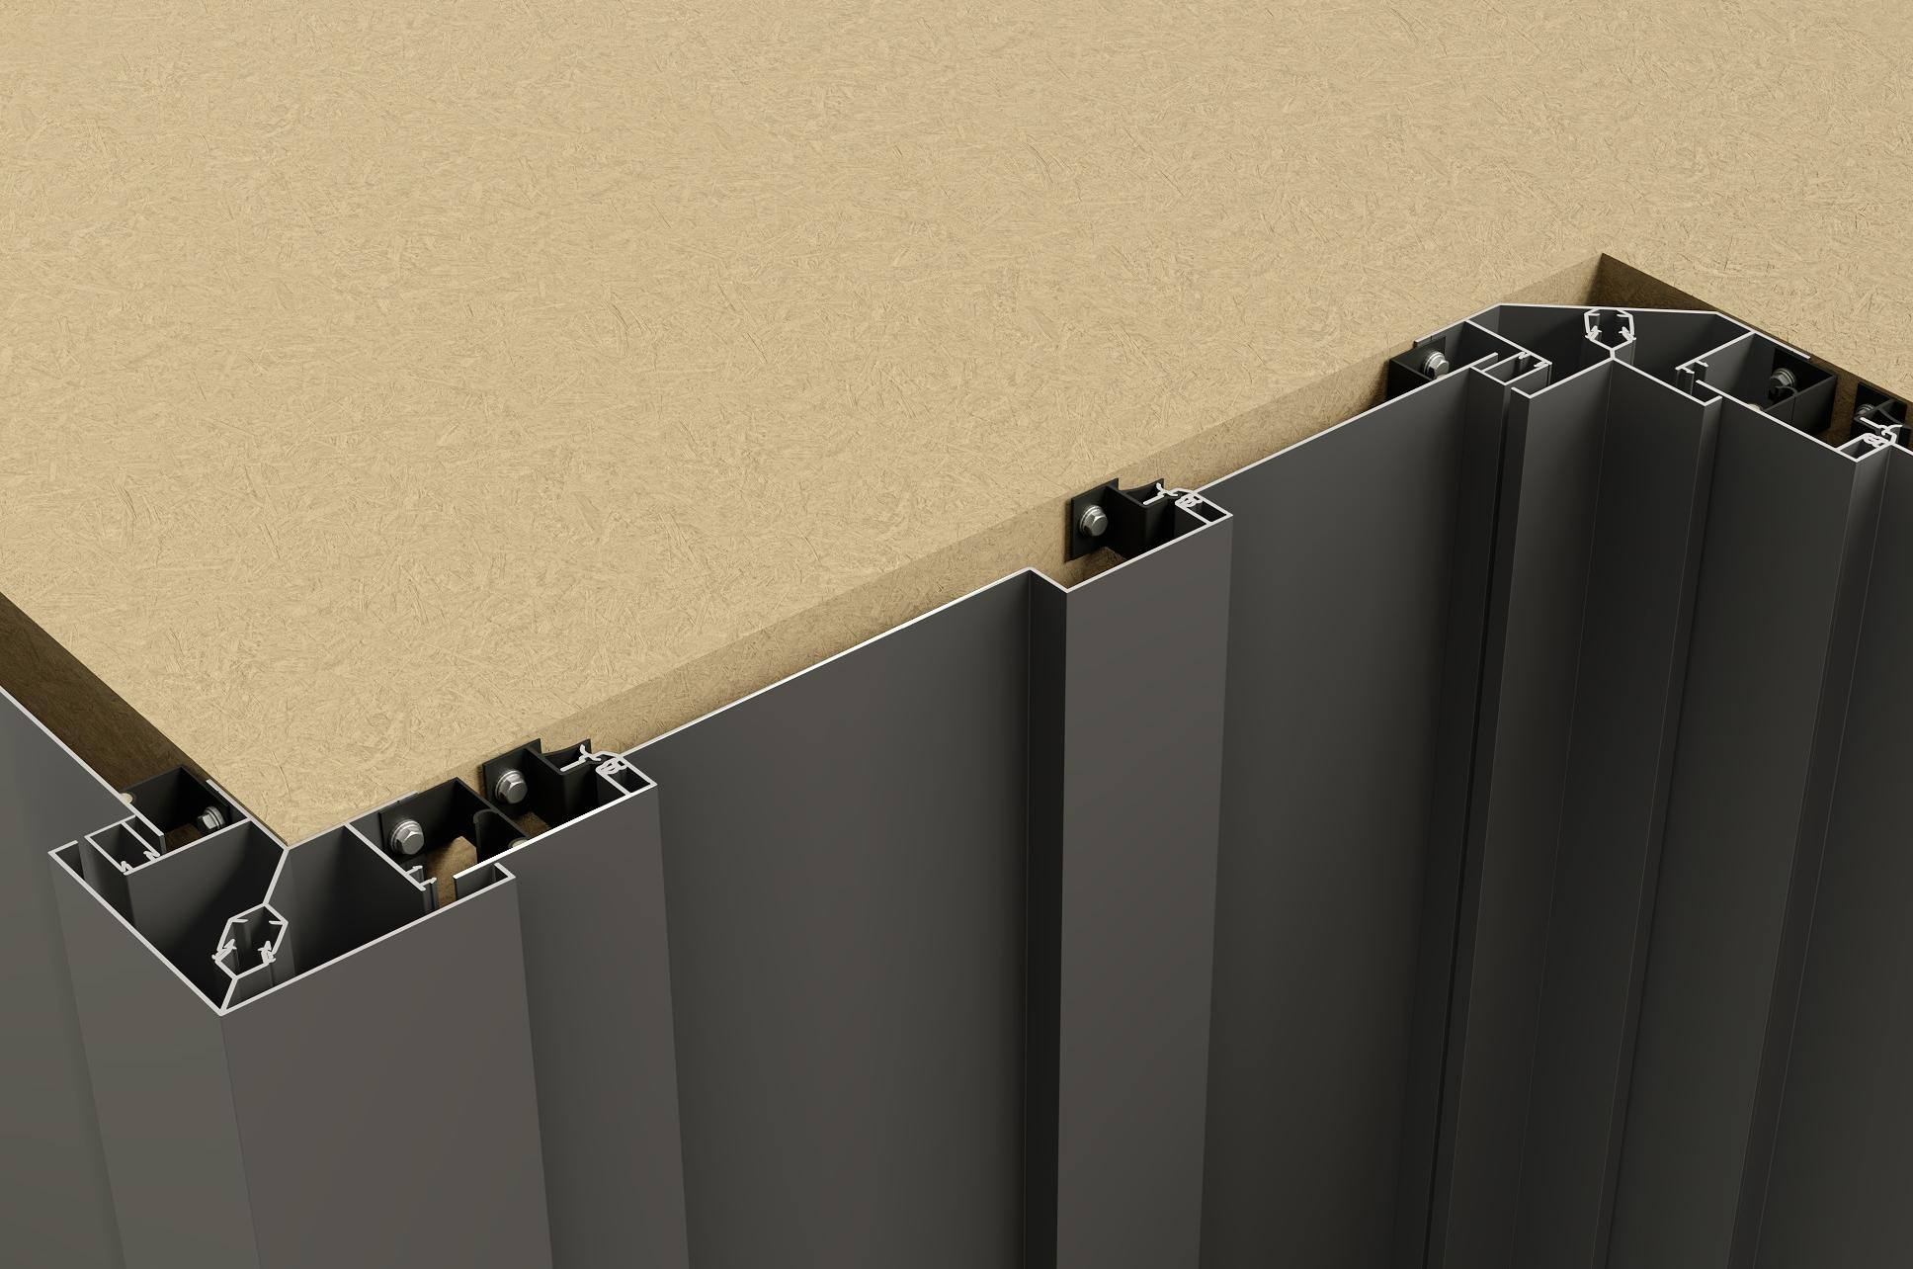
A Smarter Process
Simplified Sourcing
Faster Installation
Zero Maintenance
One integrated source for all cladding systems and accessories.
Up to 40% faster installation streamlines project timelines.
Reduces lifetime costs with near-zero maintenance performance.
Notes:
Slide 25:
And if you’re a builder or a property owner, the day-to-day benefits are just huge. Sourcing gets way easier because it’s all one system.
Installation claims to be up to 40% faster.
And the maintenance down the road drops to pretty much zero. For decades.

Slide 30
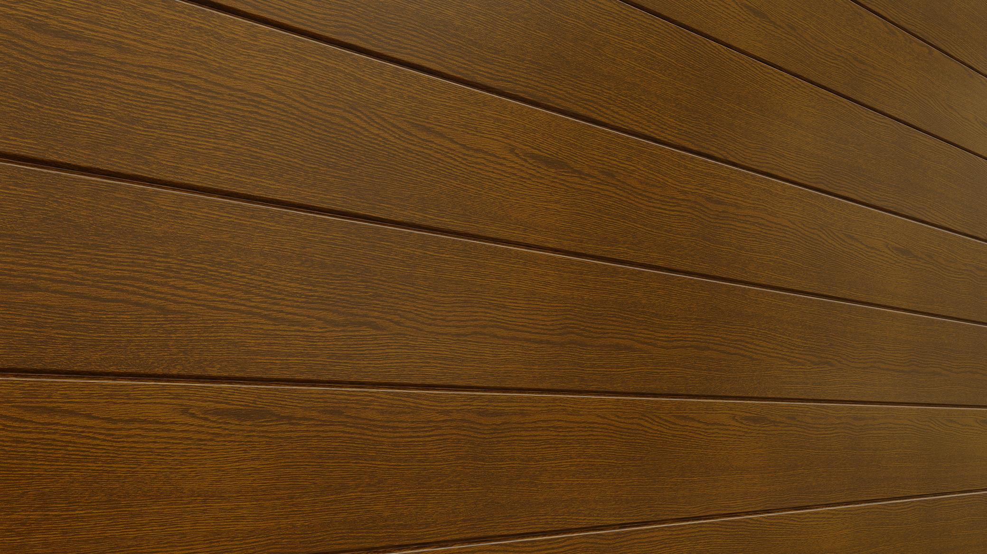
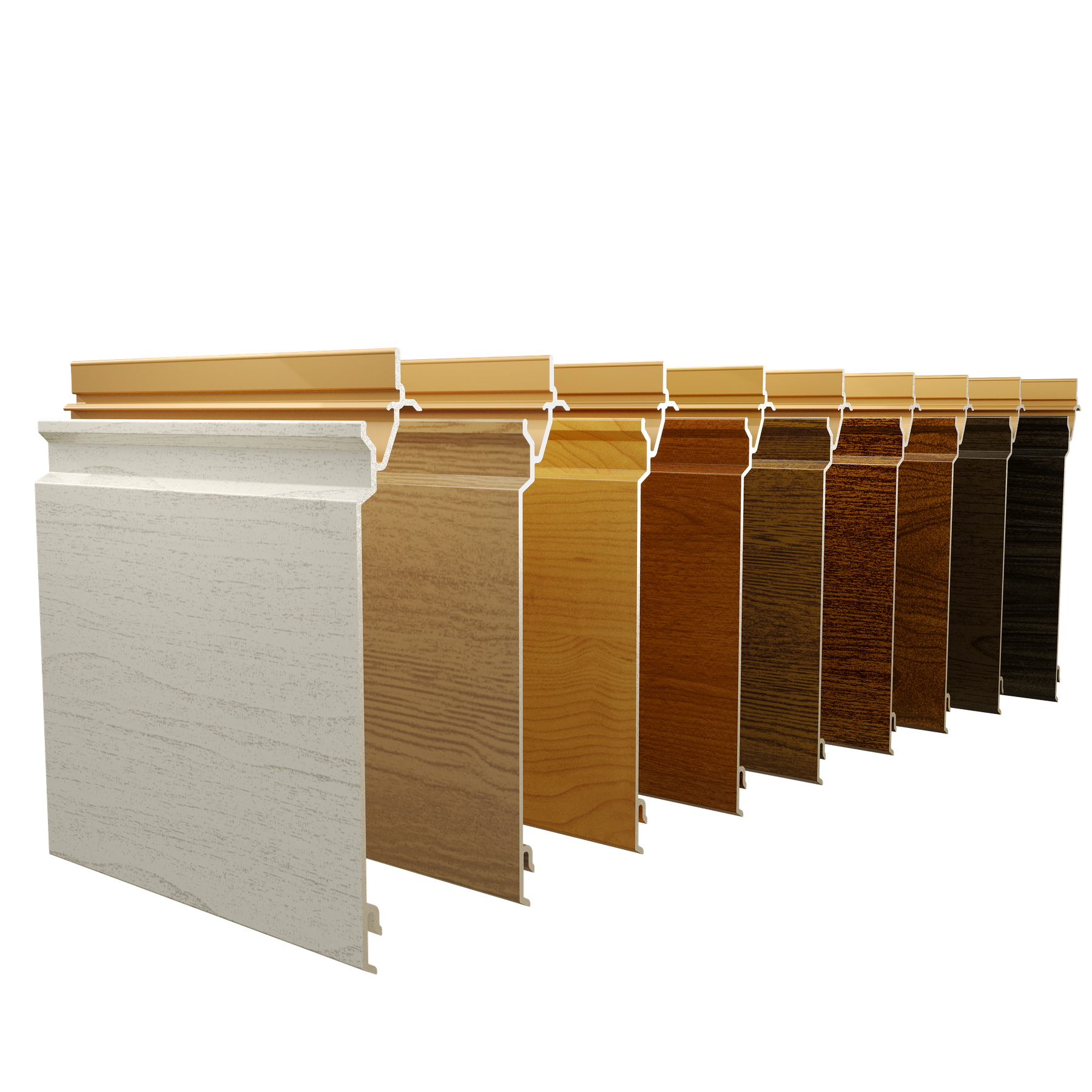
Our Finish
Engineered to resist fading for over 30 years.
Notes:
Slide 26:
And that’s not an exaggeration. We’re talking about a finish that’s engineered to resist fading for over 30 years! 30! Think about that… The colour the architect chooses on day 1 is the color you’re still going to be seeing 3 decades later. That is a massive leap forward.

Slide 31



Sustainablility
Aluminum Core
100% recyclable.
Powder Coating Process
super clean process, low in harmful chemicals and creates almost no waste.
Notes:
Slide 27:
And of course there’s the sustainability angle, which is so important today.
That aluminum core we talked about is 100% recyclable.
And the powder coating process is a super clean process, low in harmful chemicals and it creates almost no waste.

Slide 32

For centuries we have designed buildings around their limitations. What happens when those limitations disappear?
Notes:
Slide 28:
That brings up to this finally really big idea.
For centuries we’ve designed buildings around what our materials couldn’t do. We’ve designed around their limitations. But what happens when those limitations disappear?

Slide 33

If the outside of our buildings can be both intensely beautiful and essentially permanent, what does that unlock for the future?
Notes:
Slide 29:
If the outside of our buildings can be both intensely beautiful and essentially permanent, what does that unlock for the future?

Slide 34

If beauty and performance coexist, what new architectural era begins?
Notes:
Slide 30:
What kind of world are we going to build next?

